Slide 1
Garth Conrad VP Quality Medtronic
Advanced Analytics to Improve Medical Device Quality

Slide 2
Advanced Analytics to Improve Medical Device Quality
Product Data
Advanced Analytics
Better Information
Informed
Decisions
Improved Patient Outcomes
Objective:
To develop and pilot a process that will provide information to customers to use when making decisions about which medical device has the highest quality and thus greatest value to the patient. The outcome of these decisions is to improve access to quality medical devices, leading to improved patient outcomes.
Potential barriers:
No standards for quality of data or method of collection (measures and metrics)
Manufacturers not willing or able to provide data
No standard for analytics that provide most useful information
Customer not knowledgeable of how to access or use information

Slide 3
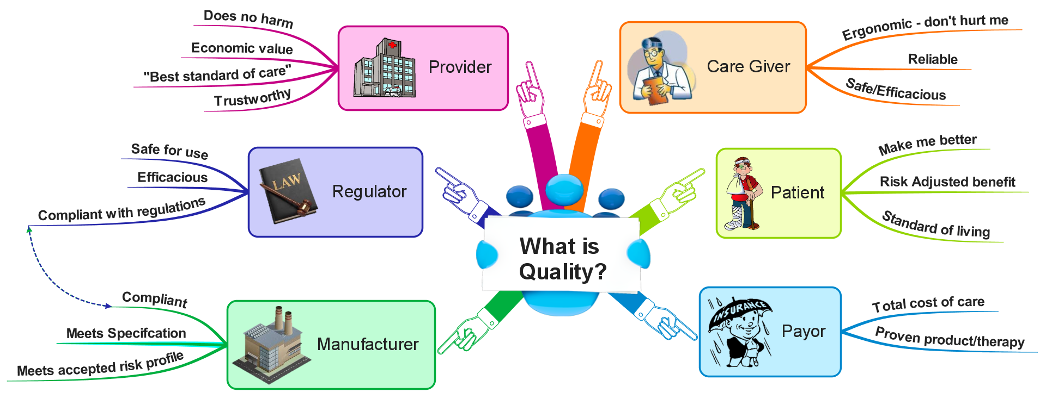
Who is the customer?

Slide 4
Hypotheses and Research Questions
Assumption: Stakeholders use data to make decisions to improve patient access to high quality devices.
Hypothesis | Research Questions
If stakeholders had access to unbiased and relevant information about product quality then they would make better informed decisions. | What information should stakeholders use to determine product quality? What information do stakeholders use today?
If stakeholders consistently applied KPIs and analytical methods to measure product quality then they would make better informed decisions. | What KPIs and analytical methods should stakeholders use? What KPIs and analytical methods do they use today?
If there were a secure process or operating model to enable and encourage individual companies to be fully transparency about product quality, they would share this information. | What information about product quality do manufacturer’s share today? What is the gap between what is shared today versus what information stakeholders need? What are the challenges to closing the gap (what would it take for companies to disclose this information)?
If stakeholders had unbiased and relevant information from companies and applied consistent KPIs and analytical methods, they would make better informed decisions | How would a stakeholder’s historic decision been different if they applied the proposed data and analytics?

Slide 5
Voice of Customer
“Trust = self service model”
What information do VAC/VAPs use to make a decisions about Quality of Product?
(1) MAUDE
(2) Field Corrective Actions
(3) Service experience
Need information (characteristics & facts) not data.
Specific to decision being made.
Mechanism for manufacturer interaction (e.g. what fixes put in place)
What assistance is needed?
Standardization of how to gather information
Quality of information available is critical
Could use assistance in identifying what is important (critical to quality) about the technology

Slide 6
Prior work - AHRMM Survey
Association for Healthcare Resource & Materials Management (AHRMM) received 165 responses to the survey. More than 80% of the responders indicated that the following criteria were “extremely important” or “very important” when making purchasing decisions about all medical devices.
Improved patient outcomes
Cost per unit
Demonstrated ability to supply
Improved operational efficiency
Durability of device
Clinicians ease of use (interface, programming, etc.)
Adverse Events
Recalls
Comparative Benchmarking of similar devices
104 Hospitals identified one or more of the following data sources as data routinely considered before making a medical device purchase
 | Number responses | % of responses
Clinical trial data | 74 | 0.71
FDA Medical Device Adverse Event Reports (MDR) | 74 | 0.71
ECRI reports | 73 | 0.70
Comparative benchmark reports | 69 | 0.66
MD Buyline | 53 | 0.51
Patient/consumer reports | 29 | 0.28

Slide 7
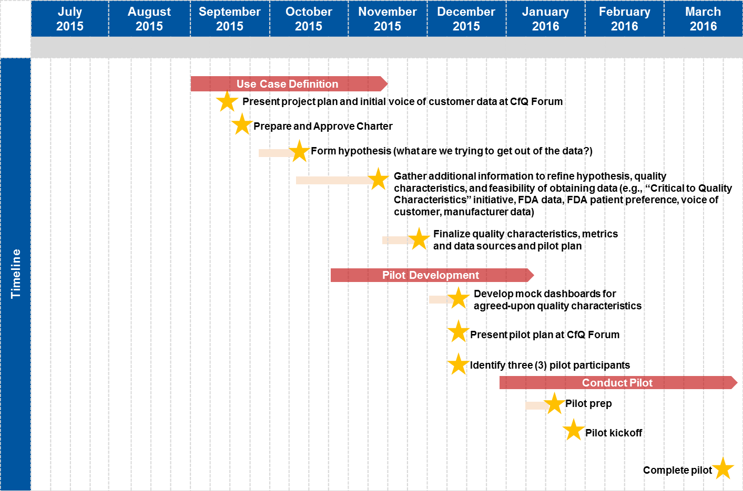
Project timeline and milestones

Slide 8
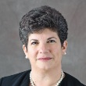
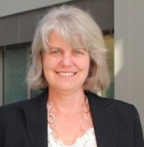
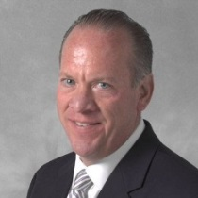
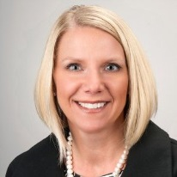
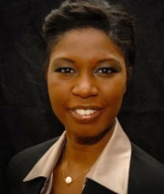
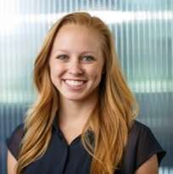
Team Members
Joanna
Engelke
Boston Scientific
joanna.engelke@bsci.com
Garth
Conrad
Medtronic - Spinal
garth.conrad@medtronic.com
Ann
Ferriter
FDA
Ann.Ferriter@fda.hhs.gov
Mike
Schiller
AHRMM
mschiller@aha.com
Steering Committee Sponsor
Project Leader
Jacqueline
Berretta
J&J - ASP
jberret@ITS.JNJ.com
Jeff
Kaser
J&J - Depuy
jkaser@ITS.JNJ.com
Nathan
Soderborg
Exponent
nsoderborg@exponent.com
Melissa
Lalomia
Stryker
melissa.lalomia@stryker.com
Daniel
Matlis
Axendia
dmatlis@axendia.com
George
Serafin
Deloitte & Touche LLP
gserafin@deloitte.com
Rahmat
Muhammad
Deloitte & Touche LLP
rmuhammad@deloitte.com
Danqing
Yu
Deloitte & Touche LLP
danqyu@deloitte.com
Rachael
Marshall
Deloitte & Touche LLP
ramarshall@deloitte.com
Project Manager

Slide 9
Questions?

