Slide 1
FDA Perspectives: Advancing Medtech Quality and Innovation
Cisco Vicenty
Compliance and Quality Staff
Office of Product Evaluation and Quality
Center for Devices and Radiological Health
March 3, 2020

Slide 2
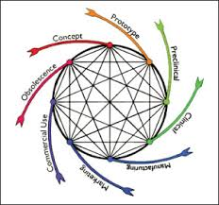
Least Burdensome
Enhance Toolbox
Enabling Change

Slide 3
Appropriated Activities
Develop a new framework that will include a voluntary program for device manufacturers to receive certification for meeting objective manufacturing and product quality criteria.
FDA will recognize third-party certifiers and offer regulatory incentives for manufacturers who demonstrate capability and transparency around their manufacturing and product performance. Including adopting the practices and technology that increase innovation, reduce cost, and improve quality

Slide 4
How does it come together?
Regulatory Research
(MDIC)
FDA
Industry
Voluntary Improvement Program
(VIP)
Medical Device Information Analysis and Sharing
(MDIAS)
Appraisal Method
(CMMI)
TTP
(MITRE)
Providers
Payers
Patients
CfQ Community

Slide 5
A new, collaborative, and data-driven regulatory model
CDRH
Visibility
Least burdensome
Safety & Innovation
Problem solving
Make abnormal conditions stand out
Address problems immediately
Prevent
Reduce error
Direct observation
Improve information exchange
Increase value
Simplification
Accelerate product improvement
Improve patient outcomes
Accelerate new technologies
Accelerate market access

Slide 6
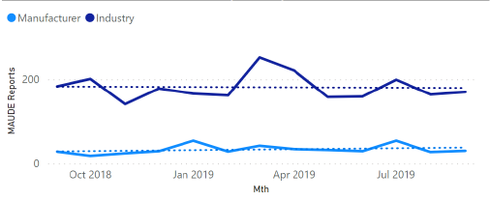
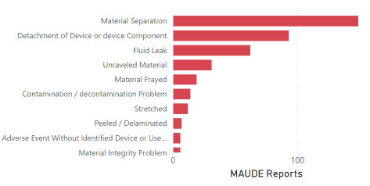
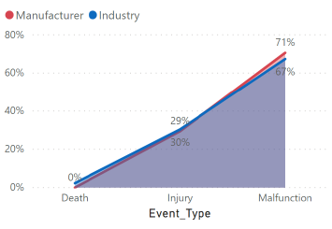
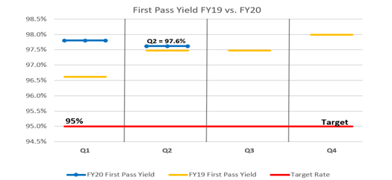
Data driven engagement
Manufacturer issue reporting vs Industry
Quarterly issue trending
Demonstrate design and development control through logically linking and error proofing requirements, risk elements, and evidence
Enable high traceability and granular revision control of data elements
Integrate closed-loop real-world feedback
Promote rapid learning cycles and continuous improvement in design
Move from reactive, to responsive and proactive
Top 10 Product Failure Modes and Risks
Industry Comparison
Relative Risk Trending
Product First Pass Yield
Notes:
Cisco / Jason – should we update based on what we have recently learned?

Slide 7
Questions?

Slide 8
Thank you

