Slide 1
Case for Quality Forum
McLean, VA
March 12th, 2020

Slide 2
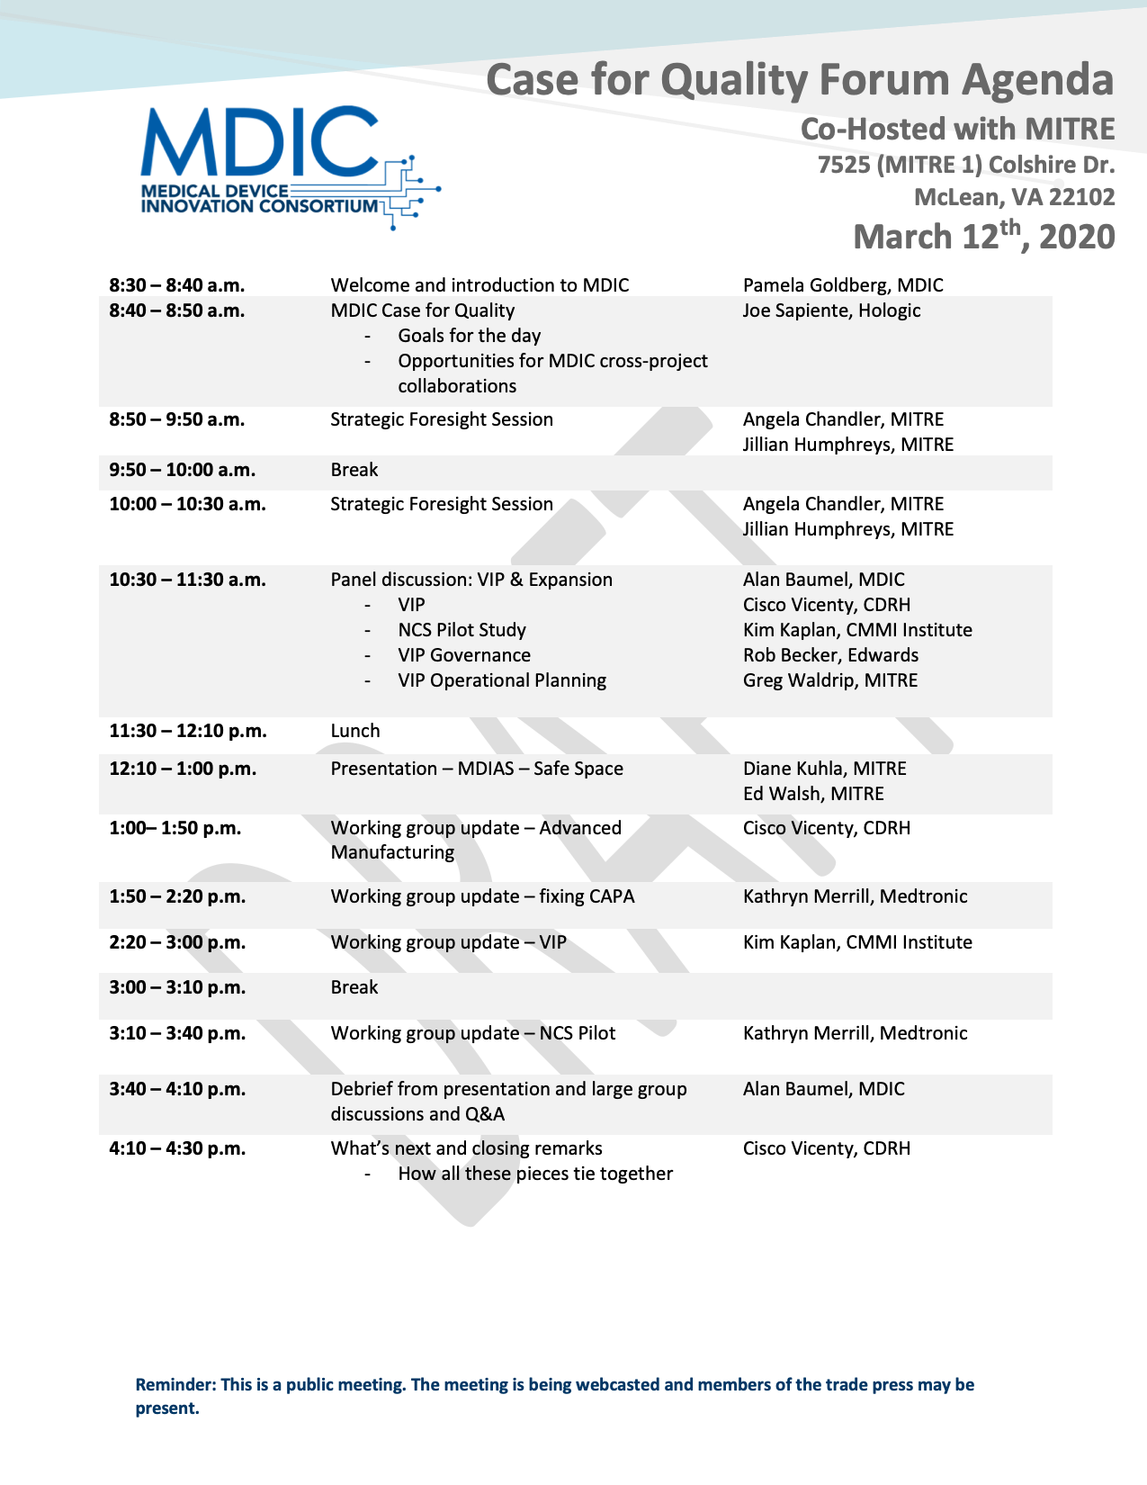

Slide 3
Goals for today
Collaboration and engagement from all attendees
Drives momentum
Supports our mission and vision
Supports CHDRH priorities
Continue to shape and influence across the medical device quality ecosystem
Today, we have an opportunity to
Engage in a strategy discussion
Learn and collaborate on VIP & Expansion, Safe Space
Engage in a discussion on CAPA and Non-Compliant Site pilot study
Learn and collaborate on new approaches to innovation, quality, and manufacturing
What is next, what does Case for Quality 2020 look like?

