Slide 1
Leadership Engagement
Pat Shafer, Joe Sapiente, Francisco Vicenty, Sara Sulfridge, Medha Trevidi
April 28, 2021

Slide 2
Our Mission
15+
Move from a culture of compliance to a culture of quality
Influence CEOs and key leadership of medical device companies to lead / champion quality initiatives in a meaningful way that will effect positive change in their organizations and the industry.
Promote Quality as a "strategic priority" being integral to all parts of an organization through strong leadership, strategic alignment, and tone at the top.
Team members
Joseph Sapiente
Pat Shafer
Sara Sulfridge
Robin DiNardo
Medha Trivedi
Prakash Patwardhan
Jackie Torfin
Ramakrishna Pidaparti
George Zack
Segolene Balling
Ashley Johnson
Alan Baumel
Jon Hunt
Stephanie Christopher
Steve Silverman
Paul Arrendell
Neil Kelly
Jason Amaral
Approach

Slide 3
Culture of Quality Baseline
15+
88 complete responses, baseline average is 71% agree or strongly agree
Neutral or Disagree
Strongly Agree
or Agree
Neutral or Disagree
Strongly Agree
or Agree
33% | 67%
22% | 78%
53% | 47%
61% | 39%
43% | 57%
Leadership promotes quality | Engage to understand behaviors that drive quality
Prioritize quality over cost | Effectively communicated quality strategy
Quality and my role | Focus on prevention over reaction
Quality in performance reviews | Formally measure cost of quality
Objective quality performance measures | Benchmark and share best practices
9% | 91%
37% | 63%
10% | 90%
16% | 84%
10% | 90%
Would most employees agree with leadership's view of themselves?

Slide 4
Quality and My Role
15+
Planning, training and communication help define our role with respect to Quality
One consistent overriding theme is there is a clear connection between quality goals and objectives for the organization and what is performed by any individual in the organization. Organizations may often achieve these connections through a variety of quality planning activities.
Focusing on behaviors that are understood by all staff including identifying value statements as a part of training, a slogan, a credo or a motto. The goals of these statements are to create a culture that drives towards ensuring quality, understanding of how work performed impacts patients, and driving improvement effort. Examples of these may be provided in statements such as:
“We all speak up when we notice something wrong in a blame free environment” “We all share and implement ideas to continuously improve processes and procedures” “We all understand how our actions affect patients” “Quality isn’t someone else’s responsibility. Quality begins with you. So, what can you do?”
Organizations successful in creating this connection between its members and quality further instill this through regular training activities and/or events.
Notes:
Joe, in your previous role at Covidien, you led an initiative called Quality Begins with Me.
Can you tell me about it?
Was there an expected ROI, or was this undertaken on faith?

Slide 5
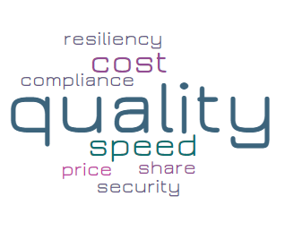
Prioritizing Quality
15+
How to move the focus from compliance to continuous improvement
Three key behaviors will help setup this new environment where quality is no longer something separate or unique or mistaken as a compliance only set of activities;
Use the Data - Our focus on regulations and compliance has caused us to undervalue scientific data and principles in our decision making. To correct this, we need to adopt a science first policy.
Create New Experiences - Employees dedicated to the design, development, production, and sustainability of our products are trained to adhere to compliance-based rules. These rules often translate into a check the box thinking which limits growth, accountability and innovation.
Communicate for Sustainable Change - This new environment will change our industry and demand a culture of quality. It is imperative that we communicate in a way that aids the sustainability of this culture.
Notes:
Sara, It’s always difficult to prioritize Quality over cost, especially when shareholders are clamoring for returns, and the CEO is thinking quarter to quarter. Site managers are competing against other sites for throughput and profitability.
How have you made the case for prioritizing quality?
What are some indications that a company is prioritizing quality?

Slide 6
Prevention vs. Reaction
15+
The concept goes beyond CAPA to consider core capabilities of continuous improvement, product development and supplier relationship management
Quality by Design
Supplier Quality
Ecosystem Monitoring
Continuous Improvement Culture - A Lean and continuous improvement program hits directly at the culture of staying proactive versus reactive in terms of problem solving. At its core, continuous improvement is designed to empower employees to solve problems that they encounter in their day-to-day work and gradually improve the efficiency of their work processes. This changes the employee’s role and responsibilities from being a passive actor to being an active participant of the business processes which enables the proactive culture in an organization.
New Product Development Cycle - Another preventive and proactive philosophy many high functioning industries undertake is designing for quality and designing for manufacturability during the new product development phase within R&D. Quality teams are established (DQA or NPI QA) that work as part of the new product development team, working closely with design engineers so that quality culture is pushed upstream into the product life cycle through tools like FMEA and Hazard Analysis.
Supplier Selection and Process Capability - Development of partnership with suppliers is widely recognized as a critical tool for supply chain improvement. To develop an effective partnership, it is necessary to have a small supply base and an effort to reduce the supply base to a manageable level.
Leading
Lagging
Where are you focused?
Recalls
Rework
Service Calls
Notes:
Medha, Companies are always focusing on lagging indicators, perhaps because they are easy to measure. CAPA aging, number of NCR’s, etc. But it’s hard to drive looking in the rear-view mirror.
What are some of the leading indicators you have favored?
What have you done to move thinking towards leading indicators?

Slide 7
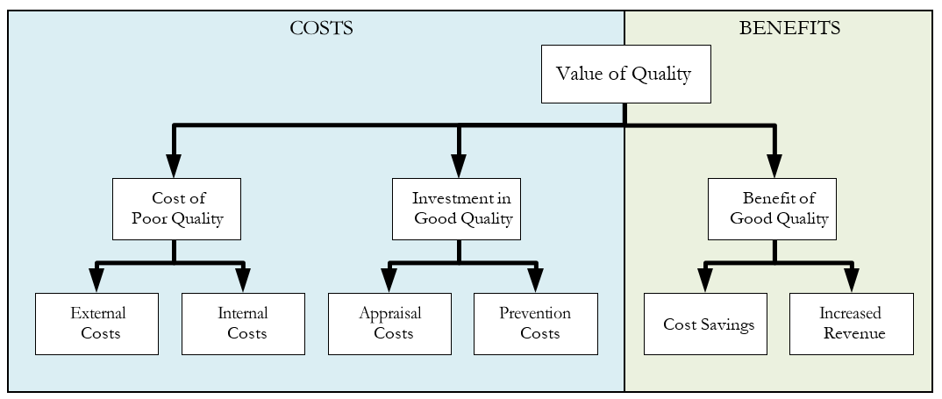
Measuring the Value of Quality
15+
Companies typically underestimate the cost of poor quality, and rarely calculate the benefits of good quality
Impact of Poor Quality on Manufacturers
Costs can be categorized as internal failure costs, those that are contained within the manufacturing ecosystem (e.g. scrap and rework), and external failure costs, those that are related to failures occurring outside the manufacturing environment (e.g. warranty claims and complaints). Both cost the organization resources, time and money.
Impact of Poor Quality on Health Care Providers
It’s not hard to imagine a hospital’s Value Analysis Committee (VAC) looking at device quality as a key purchase criterion. Device reliability (or lack thereof) can have profound cost implications for providers (e.g. income loss related to missed procedures, service costs, costs related to having to repeat procedures, and in some cases, legal fees.
Impact of Poor Quality on Health Authorities and Regulators
The Agency had seen an increasing amount of medical device recalls, from 1065 devices in FY13 to 2850 devices in FY15. From FY14 to FY15, FDA’s field organization had expended approximately 28,000 hours in monitoring medical device recalls.
Benefits of Good Quality
Ideally, all stakeholders would be interested in the size and scale of the returns on investment in good quality. Unfortunately, the benefits of good quality are rarely measured, in part because measurement is complex, in part because you can’t measure what doesn’t happen (e.g. adverse quality events).
Notes:
When the Case for Quality launched, one of the early workstreams focused on competencies, and one of those was the ability to measure the value of quality.
Have you undertaken costing and measuring value of quality in your roles as head of quality?
How have you been able to measure intangibles?

Slide 8
Our Ask: Piloting Playbook Practices
15+
Please join us if you would like to pilot one or more of the Culture of Quality best practices
Pilots should embody the following steps:
Scope – Once the practice(s) have been identified, further scoping includes determining what sites or functions will be participating and for how long.
Baseline – The purpose of the pilot is to test implementation of the practice and inform improvements in order to drive the greatest benefit. Understanding where the pilot group is starting from is essential if one is to measure improvement.
Conduct – Apply the best practices in a structured, systematic way. Conduct a formal kick-off meeting with pilot participants, explaining the purpose, what will be measured, how the pilot will be run, and each person’s or group’s role and responsibility.
Measure – Measures should be reported periodically and at the end of the pilot. Has the best practice improved performance in the expected areas? Are there any unintended consequences?
Continuously Improve – If the practice(s) have led to improvement, make plans to adopt them on a wider scale, leveraging learnings from the pilot.

Slide 9
Questions
15+

