Slide 1
Medical Device Information Analysis and Sharing/MDIAS
Al Crouse, CVRx; Owen Faris, FDA; Ravi Nabar, Illumina;
Joseph Sapiente, MDIC; Sara Sulfridge, Baxter
April 26, 2021

Slide 2
MDIAS Initiative
MDIAS is a voluntary partnership between government and the private sector formed to enhance systemic medical device data sharing, analysis, and utility.
Why MDIAS?
From fragmented and reactive…
…to systemic and predictive

Slide 3
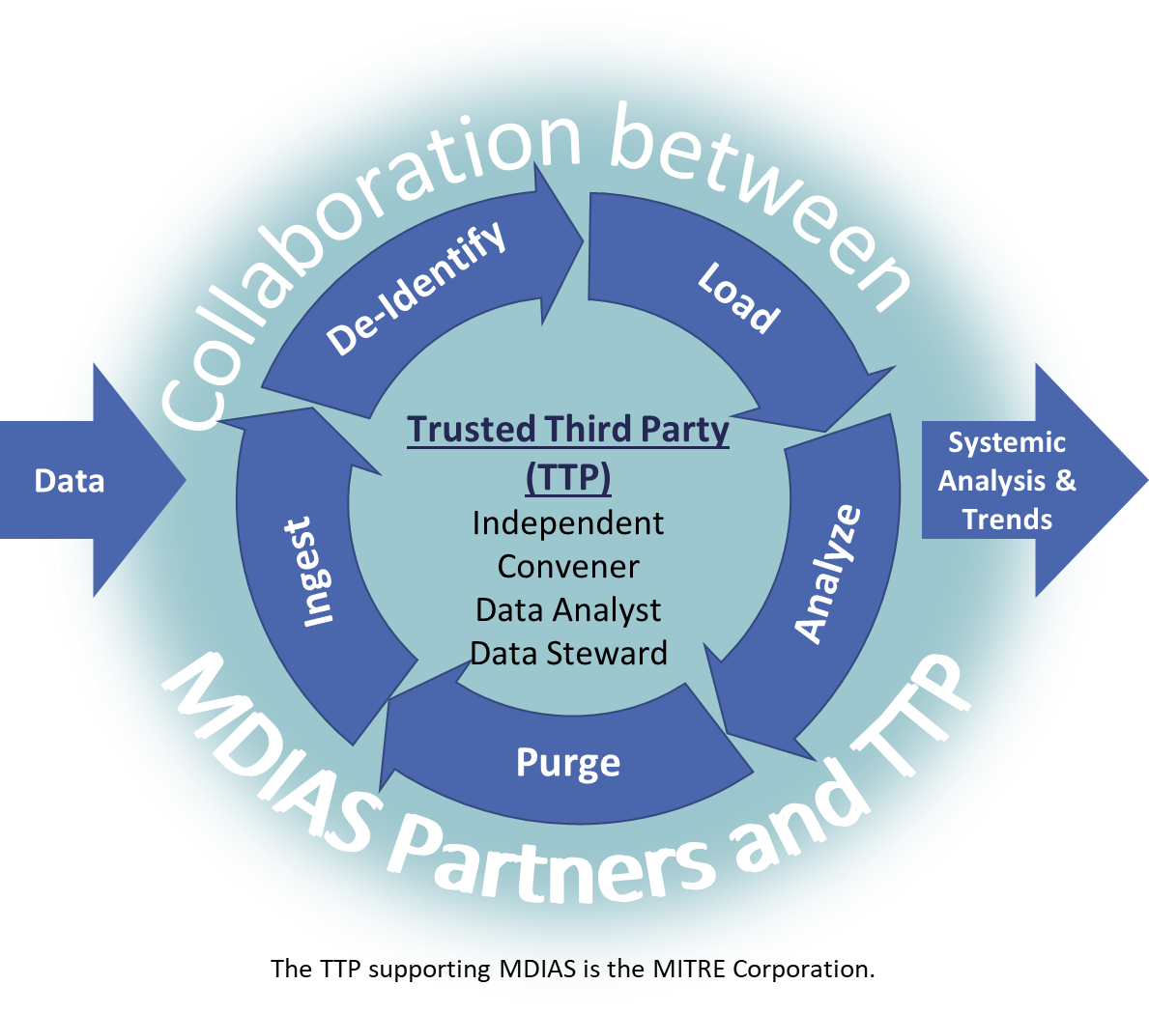
How MDIAS Works
MDIAS
Partners
MDIAS
Outcomes
Device Manufacturers
Improved Device Quality
Providers
Better Predictive Analytics
FDA
High Quality Patient Outcomes

Slide 4
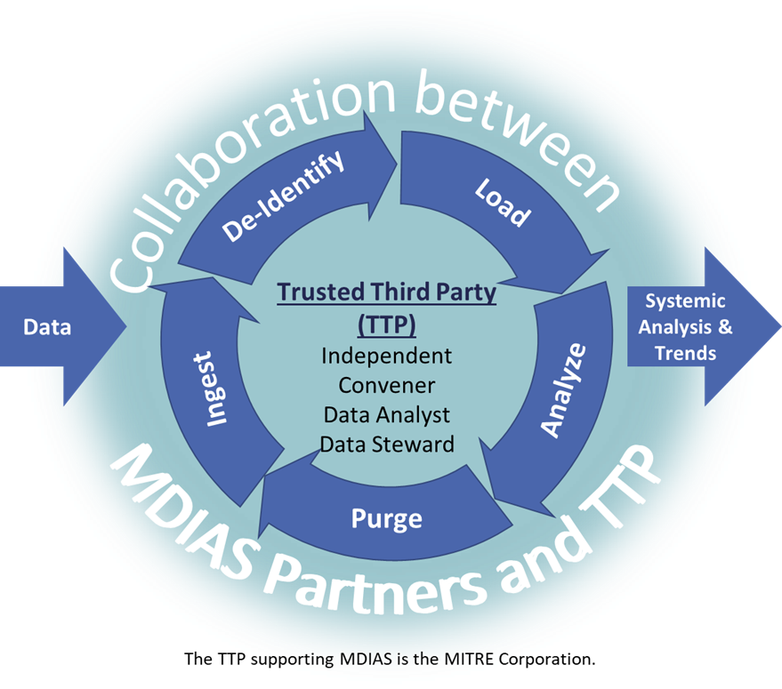
How MDIAS is Governed
Governing Committee Representation
Large and Small Medical Device Manufacturers
Healthcare Organization
FDA Center for Devices and Radiological Health (CDRH)
Governing Committee Accountabilities
Program strategy and changes
Participation requirements
Baseline performance measures
Research topics
Data collection priorities
Data dissemination

Slide 5
MDIAS Initial Studies
Two Studies Being Conducted Through Summer 2021
Topics
FDA Public Data Sources
Collaborative Analysis
Results
FDA Unified Registration and Listing System (FURLS)
MDRs hosted in the Manufacturer and User Facility Device Experience (MAUDE)
Recalls of devices (Recalls)
Root Causes of Recalls
(Use Case “P”)
1
Aggregate Results*
2
Medical Device Reports (MDRs) Predictive of Recalls
(Use Case “9”)
Trusted Third Party & Studies Sub-teams
Benchmark Results
3
*Aggregate results will also be used to create predictive models and dashboards.
Questions: contact caseforquality@mitre.org.

Slide 6
Use Case: Root Causes of Recalls
Research Question: How are the primary root causes of recalls distributed?
Study kicked off November 2020 and is slated to conclude May 2021.
Deep dive into identifying root cause trends within publicly available recalls from 2010-2019.
Outputs include Visualizations, Benchmarks, Presentations

Slide 7
Use Case: MDRs Predictive of Recalls
Research Question: Are MDRs predictive of recalls?
Reviewed and assessed FURLS, MAUDE and Recalls data content
Theorized categorizations of interest
MDIAS performed analysis based on team feedback
Early indications show possible correlations to implantable, single-use products and are more likely in those products with earlier recalls or similar products with recalls

Slide 8
Q & A
Al Crouse, CVRx; Owen Farris, FDA;
Ravi Nabar, Illumina; Joseph Sapiente, MDIC;
Sara Sulfridge, Baxter

