Slide 1



Symposium on Computational Modeling and Simulation
Generating Regulatory In Silico Evidence
April 16-17, 2024
Hyattsville, MD
College Park Marriott Hotel & Conference Center
REGISTER NOW
#ModSim2024

Slide 2
Discover the latest innovations in CM&S
The MDIC Symposium on Computational Modeling and Simulation (CM&S), will take place in the Washington DC Metro Area from April 16-17, 2024. Co-organized by medical device industry leaders and the FDA members of the MDIC Computational Modeling & Simulation Steering Committee. This event is designed to spearhead innovation and foster collaboration in the realm of computational modeling and simulation for the advancement of regulatory-grade evidence in the medical device industry. Join us to discover the latest innovations in computational modeling and simulation for developing in silico regulatory evidence.

Slide 3

CM&S Pre-symposium Workshop
Join us on Monday, April 15 for a half-day pre-symposium workshop as part of the MDIC Symposium on CM&S.
The training sessions will be taught by subject matter experts from the FDA and medical device industry. The courses will provide overviews of each topic and will highlight the key principles through medical device examples and interactive discussions. Register for the pre-symposium workshop to join colleagues and experts from FDA and industry for an opportunity to discuss important and timely topics in depth!
Pre-conference Workshops require a $50 additional registration and fee and are not included in the main symposium registration. You must be registered for the 2024 MDIC Symposium on Computational Modeling and Simulation to register for the pre-conference workshop.
There will be three separate training sessions:
1
ASME V&V 40-2018 standard “Assessing Credibility of Computational Modeling Through Verification and Validation: Application to Medical Devices”
2
FDA Guidance on “Assessing the Credibility of Computational Modeling and Simulation in Medical Device Submissions”
3
FDA Guidance on “Reporting of Computational Modeling Studies in Medical Device Submissions”

Slide 4
What to Expect at #ModSim2024
Explore Cutting-edge Applications
Explore the forefront of computational evidence application in both clinical and non-clinical domains, where industry leaders will unveil the latest innovations and breakthroughs shaping the future of medical device development and regulatory compliance.
Real-World Case
Studies
Gain valuable insights from in-depth case studies showcasing successful approaches to assessing model credibility. Learn from practical examples that demonstrate how to navigate challenges and leverage opportunities in the computational evidence landscape.
Insights for Regulatory Decision Making
Acquire valuable perspectives on the pivotal role of modeling and simulation in the regulatory decision-making process. Uncover the potential of computational modeling and simulation in shaping the future of regulatory assessments and decision-making protocols.
Exhibition and Poster Sessions
Immerse yourself in a rich tapestry of innovation at the #ModSim2024 poster exhibits. Explore the latest tools, technologies, and advancements in computational modeling and simulation, showcasing the cutting-edge contributions of industry trailblazers and thought leaders.
Cutting-edge
Training
Dive into the intricacies of model credibility assessment and the art of effectively presenting computational evidence in regulatory submissions to the FDA. Our expert-led sessions will provide invaluable insights into best practices and strategies to ensure your models meet the highest standards of credibility and reliability.
Interactive Panel Discussions
Engage in dynamic panel discussions that foster an exchange of groundbreaking information and ideas. Discover how the industry can collectively advance computational modeling and simulation toward attaining regulatory-grade evidence, setting the stage for transformative advancements in bringing innovative devices to market.

Slide 5
Don’t Miss These Opportunities
Get a Booth! Engage the MedTech Industry
#ModSim2024 is your company's chance to make an impression on attendees from industry and FDA engaged in driving advancements in regulatory evidence, clinical trials, and computational modeling and simulation. Explore exclusive sponsorship opportunities, reserve your booth today, and put your company's stamp on #ModSim2024. Click to learn more.
Share Your Expertise with a Poster Session
MDIC is pleased to provide an opportunity for various stakeholders in the computational modeling and simulation ecosystem to showcase their work in this field through our Poster Sessions and engage with Symposium attendees. We invite poster abstracts for CM&S topics across the total product life cycle of medical devices. Click to learn more.

Slide 6
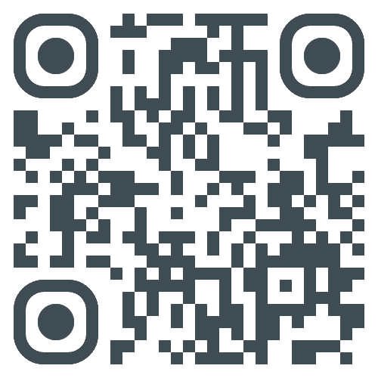
Overview
Agenda
Submit a Poster Abstract
Exhibit and Sponsor
Hotel Reservations
Discover more at
MDIC.org
Additional Inquiries?
Please contact MDIC staff at CMS@mdic.org
REGISTER NOW

Slide 7


Thanks!
Any questions?
CONTACT
Matthew Victoria
Senior Manager, Marketing & Communications
mvictoria@mdic.org

