Slide 1
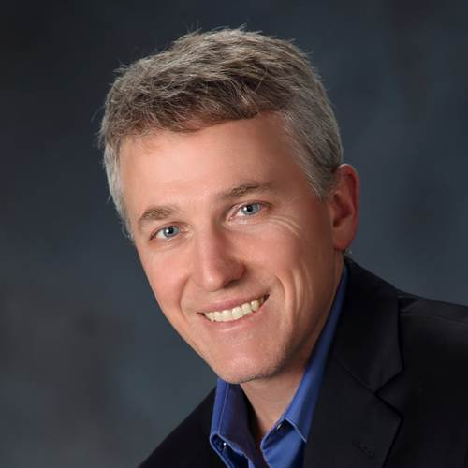
FDA/MDIC Pre-Symposium: ASME VVUQ 40 Training
Monday, April 15th
1:00 PM – 2:30 PM
Jeff Bischoff, PhD Zimmer Biomet Senior Director of Research

Slide 2
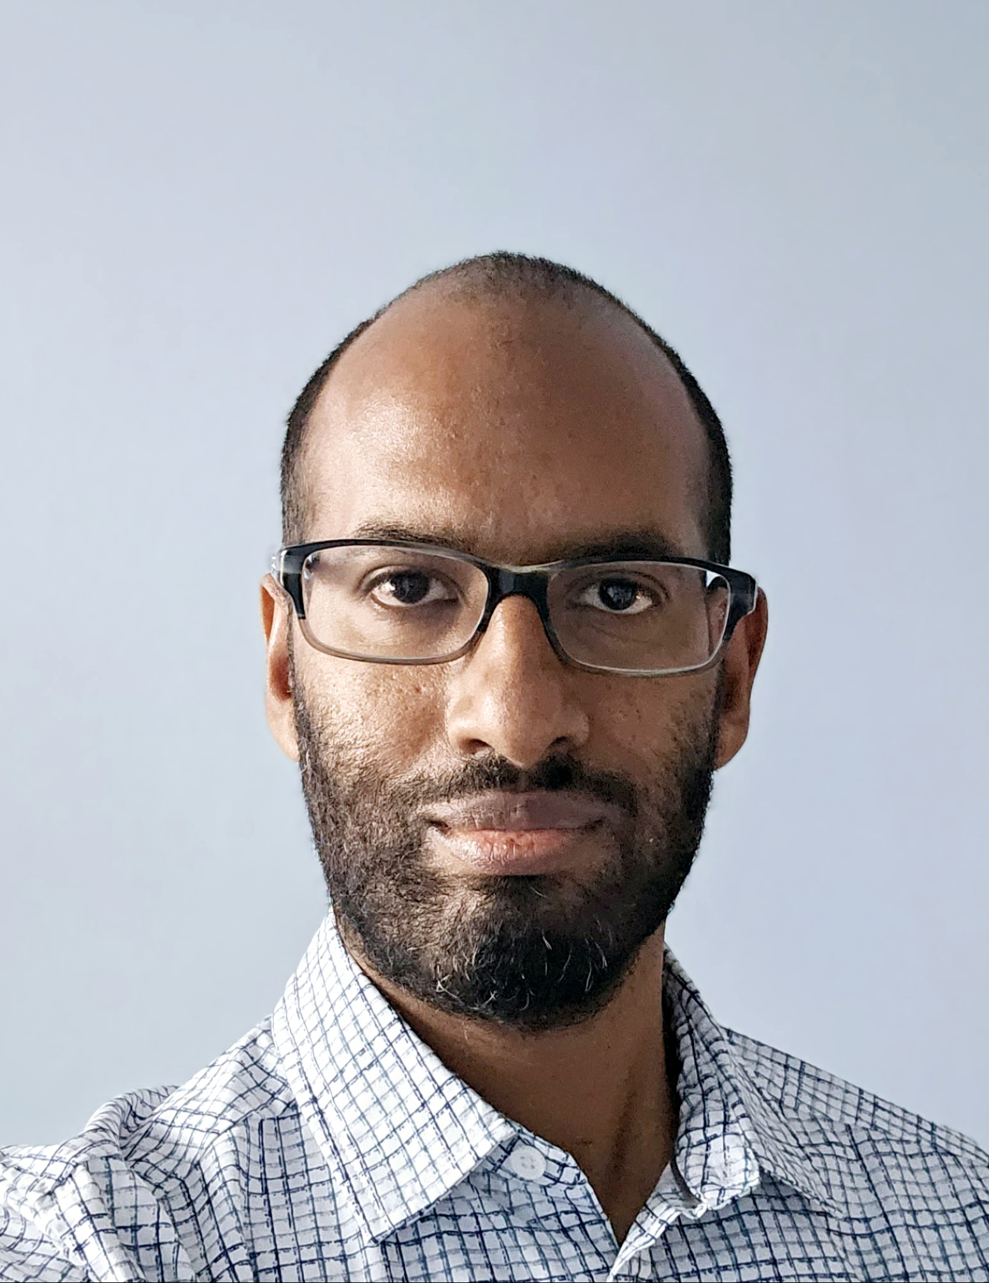
FDA/MDIC Pre-Symposium: FDA CM&S Credibility Guidance Training
Monday, April 15th
2:45 PM – 3:45 PM
Pras Pathmanathan, PhD Office of Science and Engineering Laboratories, CDRH, FDA Senior Scientist

Slide 3
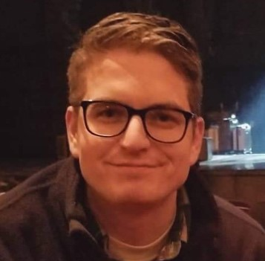
FDA/MDIC Pre-Symposium: FDA CM&S Credibility Guidance Training
Monday, April 15th
4:00 PM – 5:00 PM
Kenneth Aycock, PhD Office of Science and Engineering Laboratories, CDRH, FDA Research Scientist

Slide 4
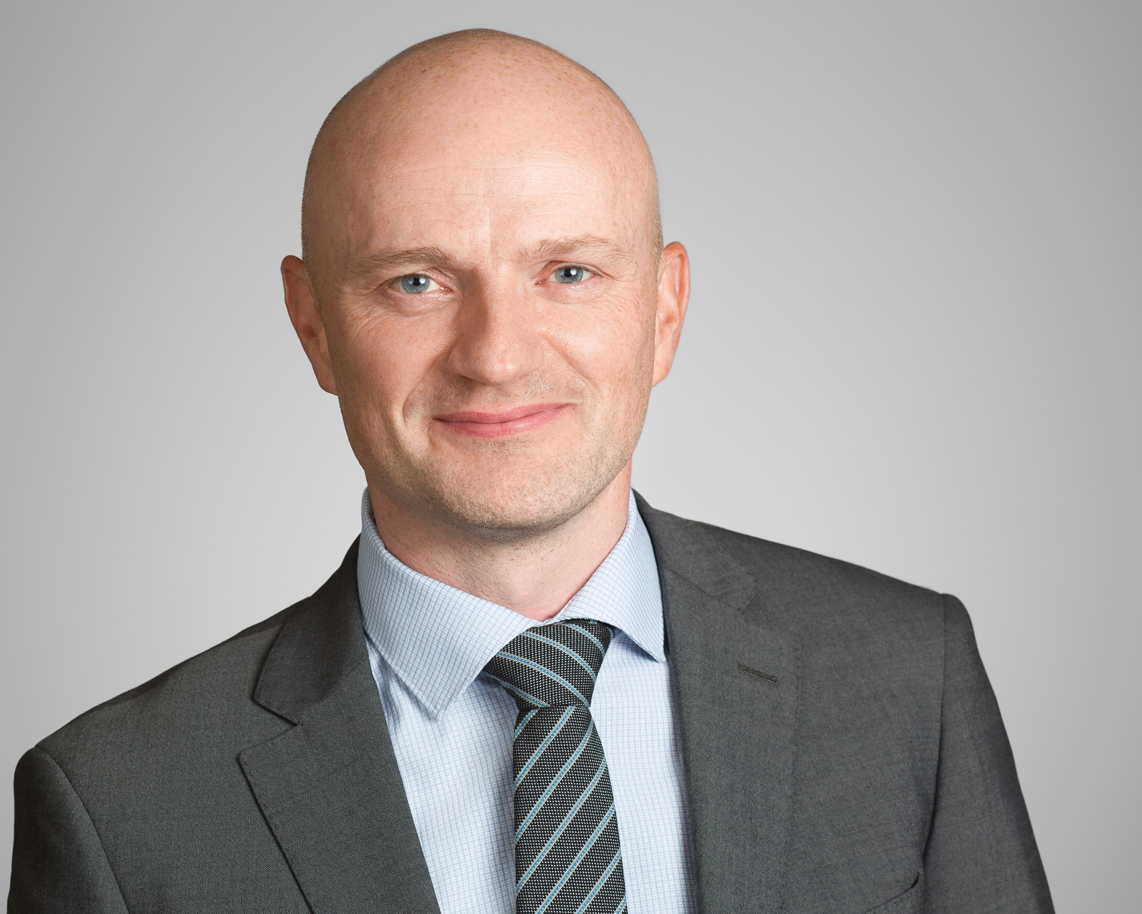
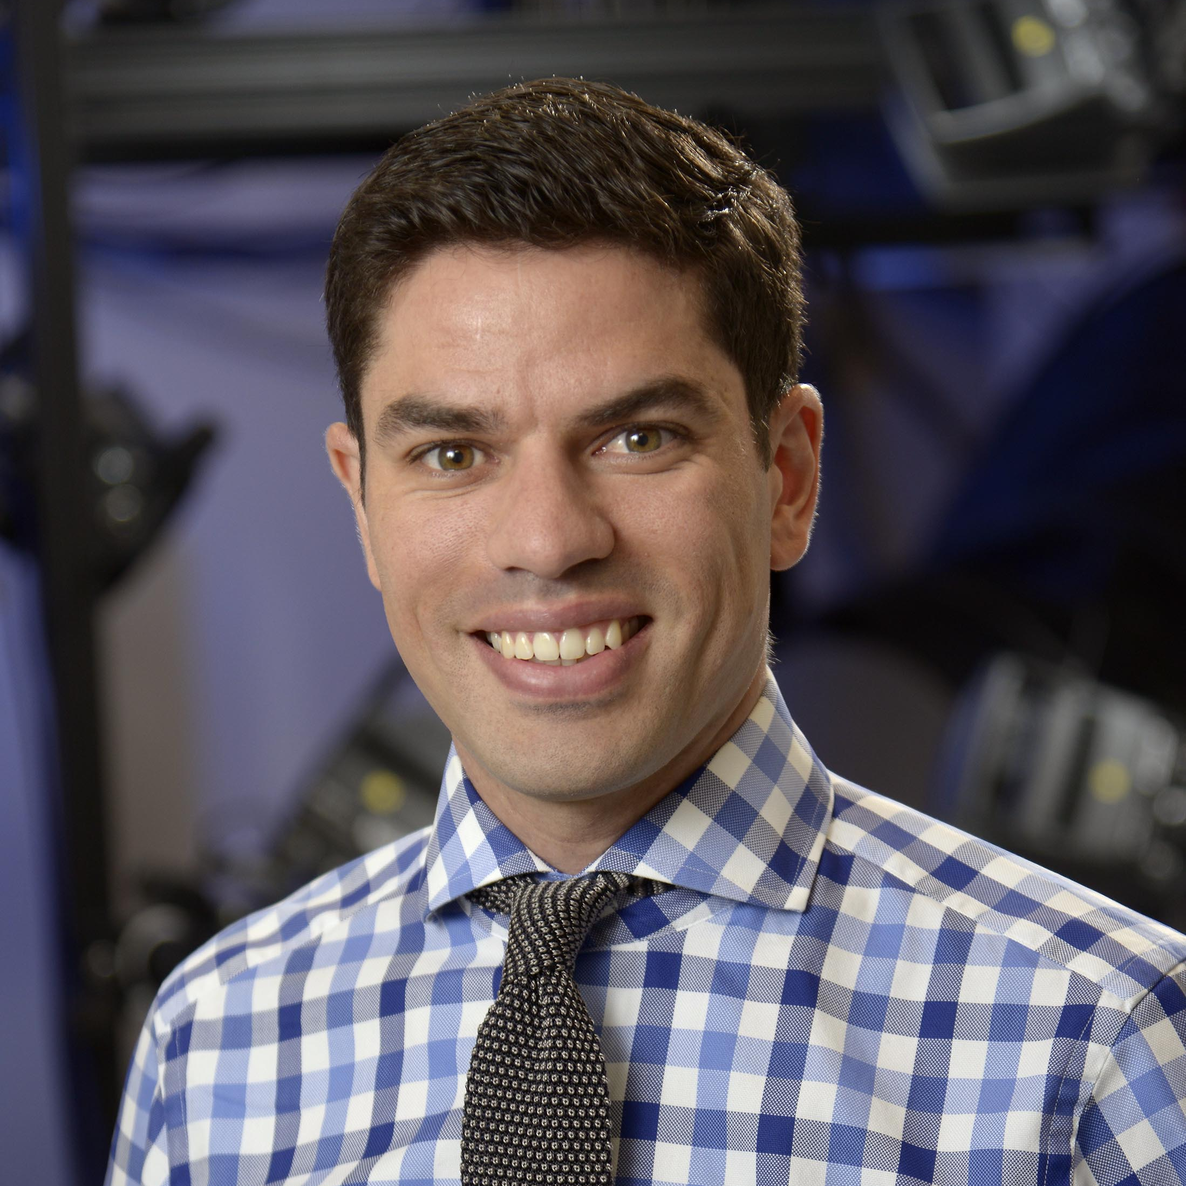
Invited Talk: Using CM&S to Guide Clinical Decision Making – What will it take for Clinicians to Trust Us?
Tuesday, April 16th
8:45 AM – 9:30 AM
Carl Imhauser, PhD Weill Cornell Medicine Associate Scientist, Hospital for Special Surgery; Associate Professor of Applied Biomechanics in Orthopaedic Surgery
Fernando Quevedo
González, PhD FDA Associate Scientist, Hospital for Special Surgery; Associate Professor of Applied Biomechanics in Orthopaedic Surgery

Slide 5
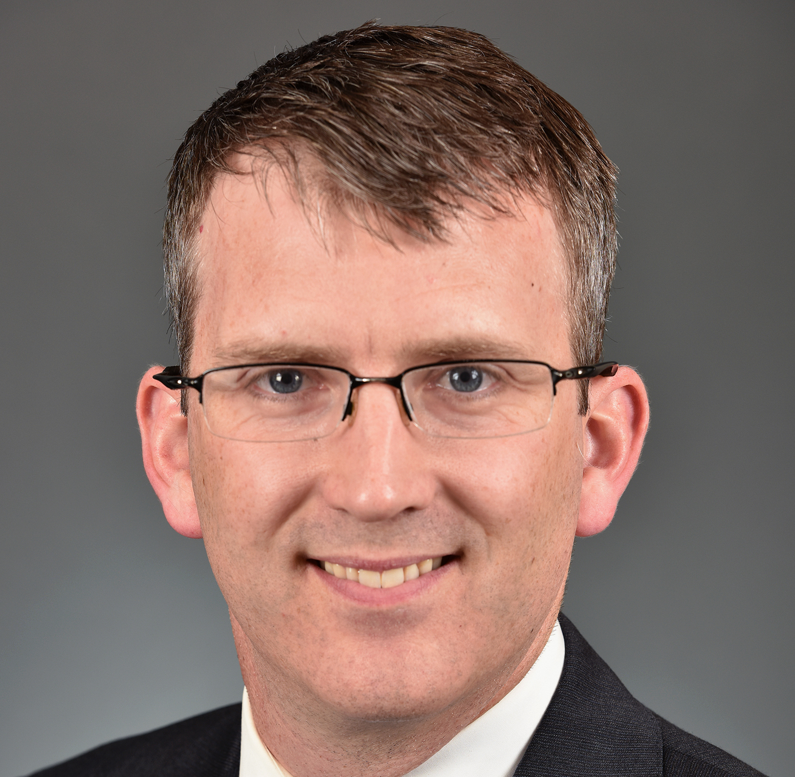
Invited Talk: Clinical Use of 3D Modeling and Simulation for Preoperative Planning and Intraoperative Guidance in Pediatric Cardiac Surgery
Tuesday, April 16th
9:35 AM – 10:15 AM
David Hoganson, MD Boston’s Children’s Hospital Pediatric Cardiac Surgeon, Assistant in Department of Cardiac Surgery and Director, Computational 3D Visualization Program, Boston Children’s Hospital; Assistant Professor of Surgery

Slide 6
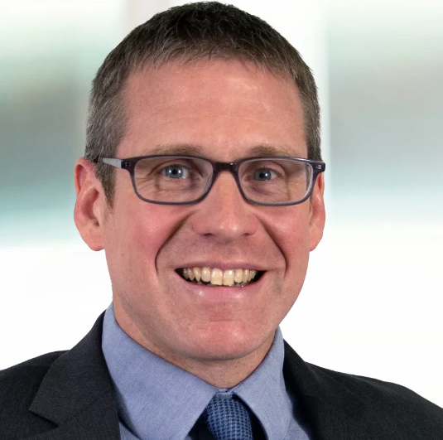
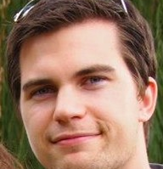
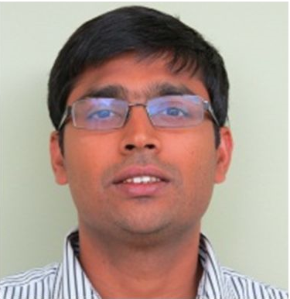
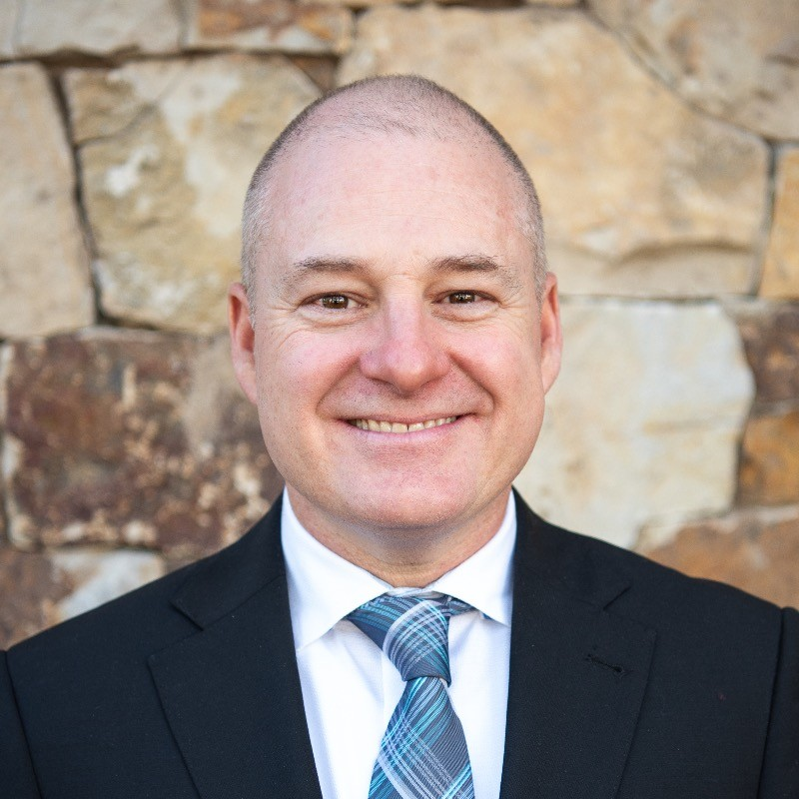
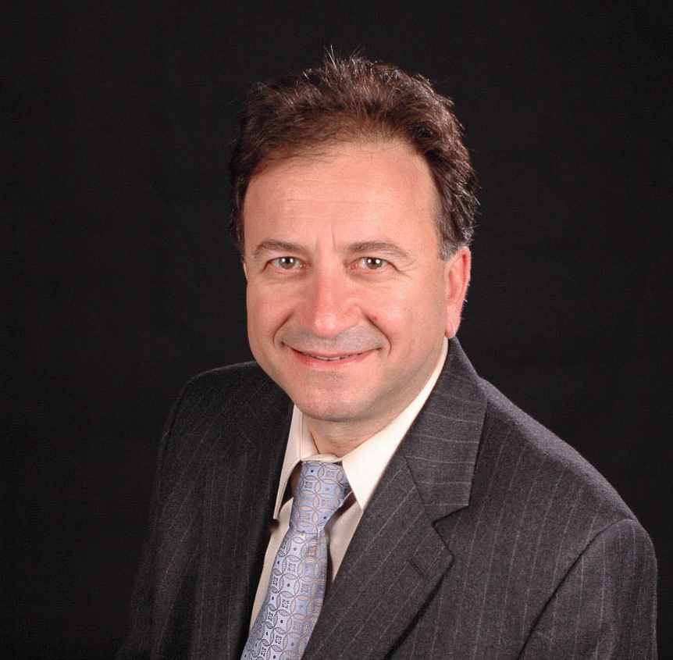
Panel Discussion: Model Credibility Assessment Case Studies
Tuesday, April 16th
10:45 AM – 12:15 PM
Paul Briant, PhD Exponent Practice Director and Principal Engineer
Mark Driscoll, PhD McGill University Associate Professor of Mechanical Engineering
Finn Donaldson, PhD FDA Team Lead, Peripheral Interventional Devices Team, Office of Cardiovascular Devices, Office of Product Evaluation and Quality, CDRH
Prasanna Hariharan, PhD FDA Deputy Director, Division of Applied Mechanics, Office of Science and Engineering Laboratories, CDRH
Brandon Lurie W.L. Gore &
Associates Modeling and Simulation Engineer
Semih Oktay, PhD CardioMed Device Consultants President & Founder

Slide 7
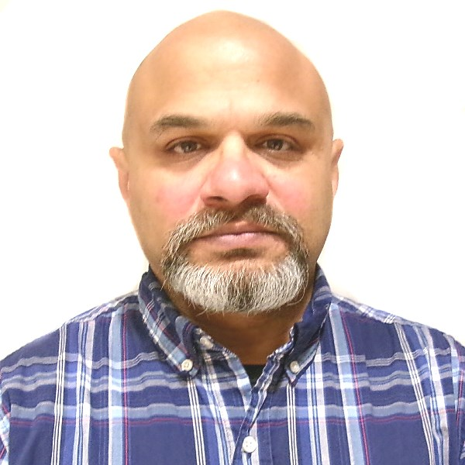
Invited Talk: FDA Perspective on Software as a Medical Device
Tuesday, April 16th
1:15 PM – 1:45 PM
Vinay Pai, PhD FDA Digital Health Specialist, Digital Health Center of Excellence, CDRH

Slide 8
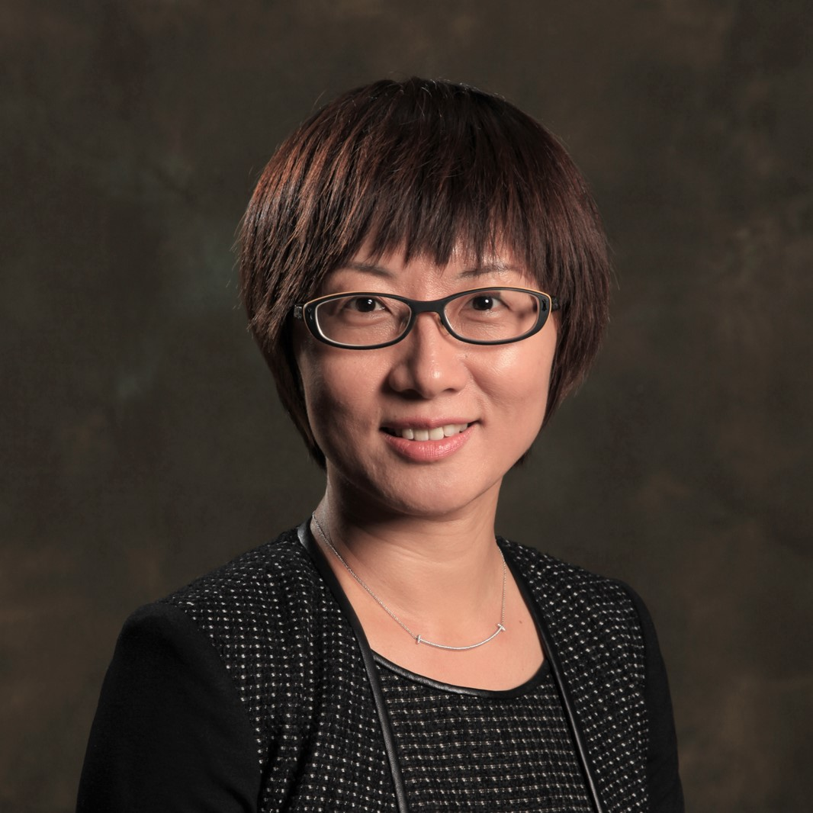
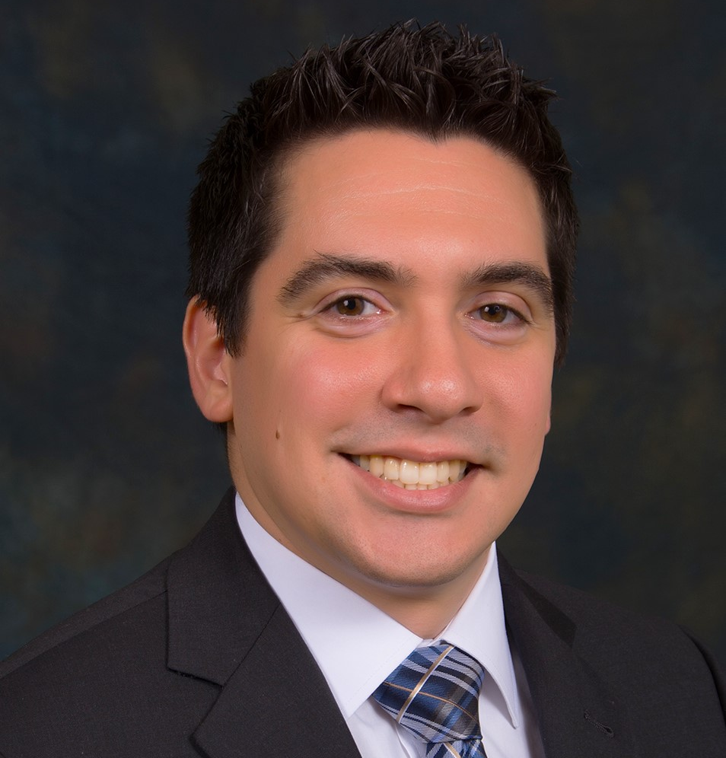
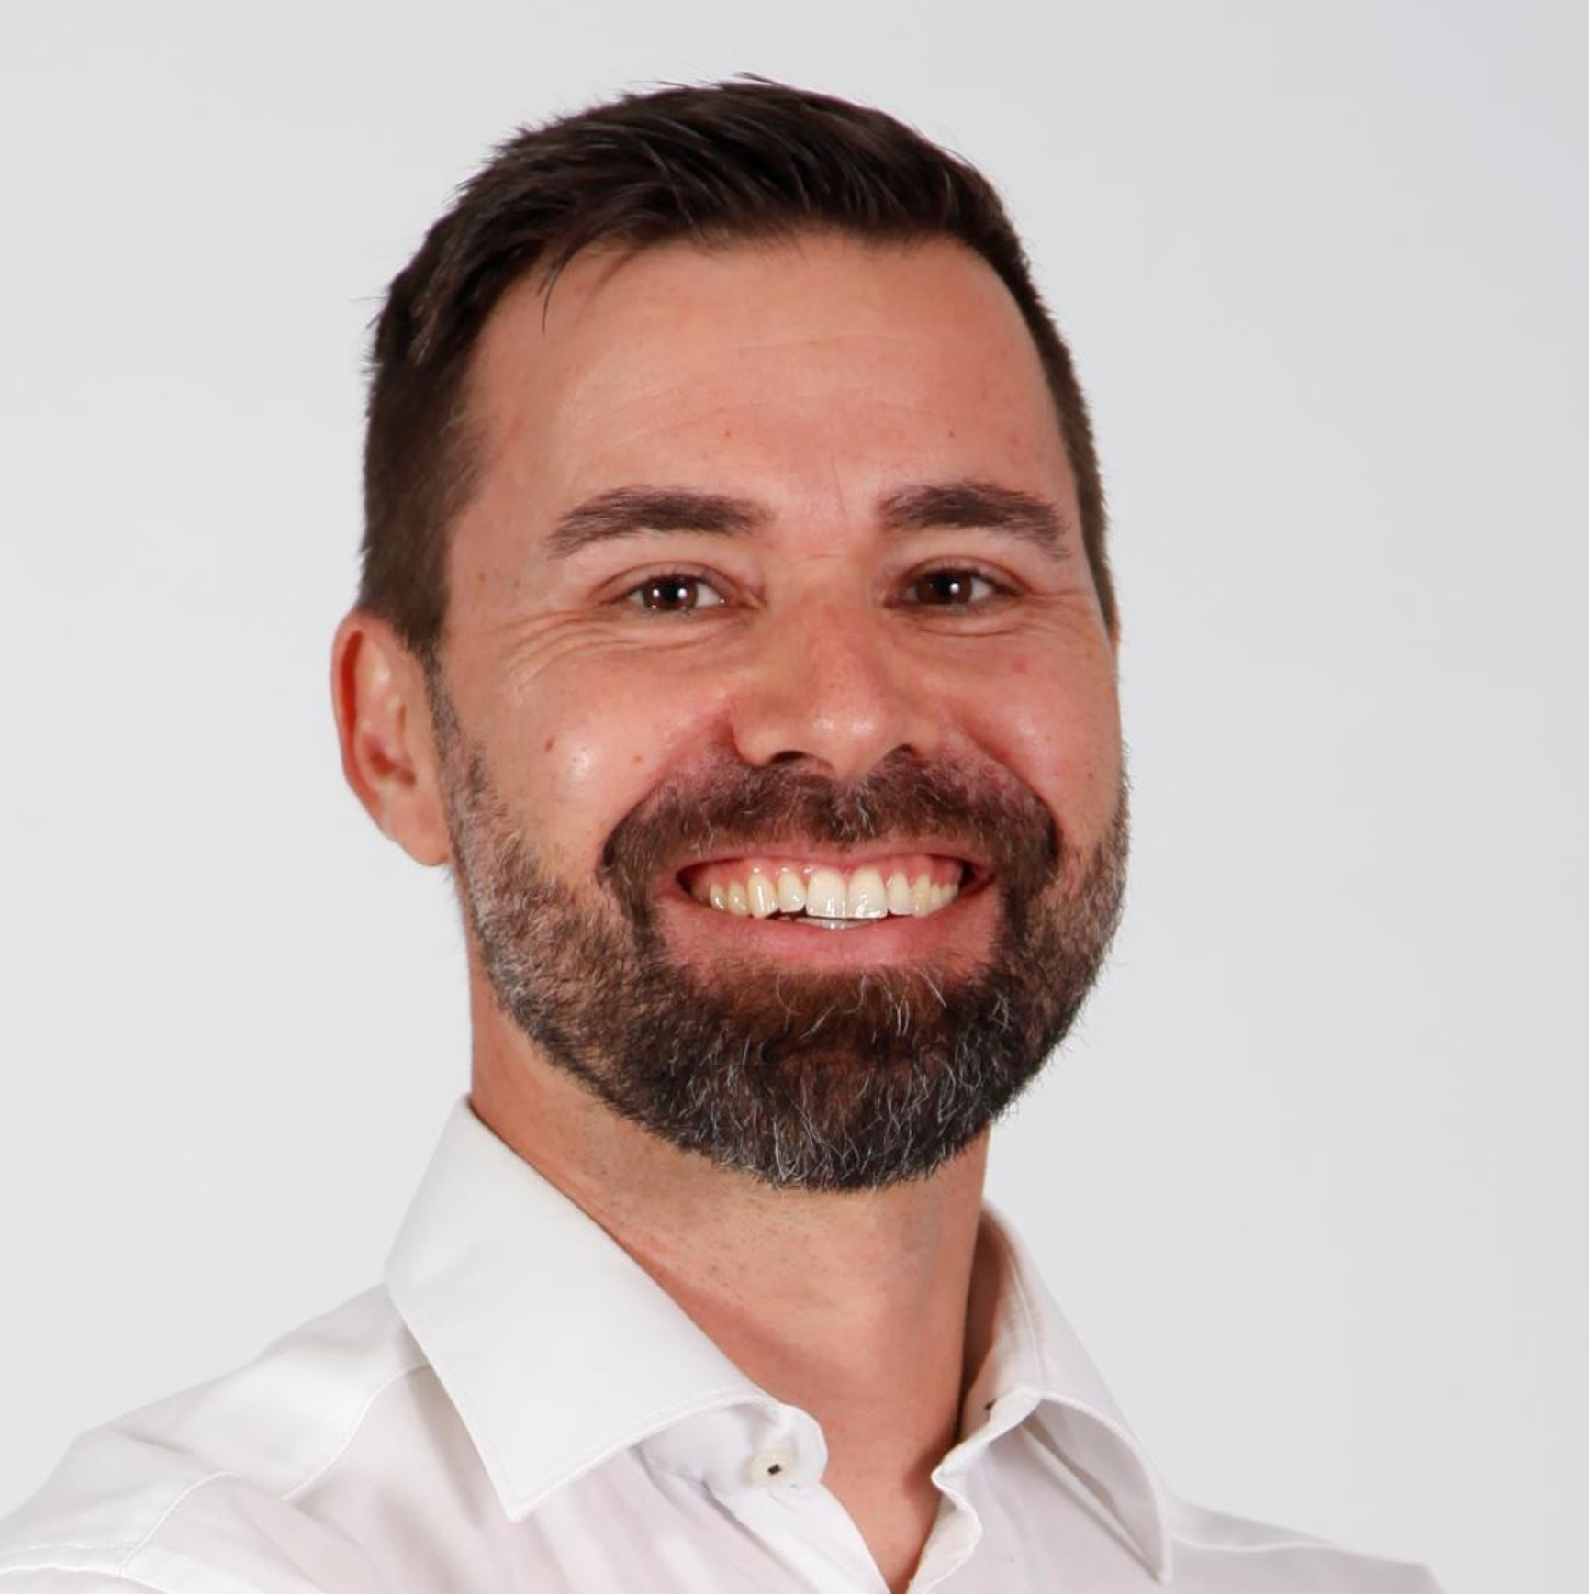
Panel Discussion: Opportunities & Challenges for CM&S of Medical Devices
Tuesday, April 16th
1:45 PM – 2:30 PM
Cheryl Liu, PhD Stryker Supervising Senior Principal Engineer
Pras Pathmanathan, PhD FDA Senior Scientist, Office of Science and Engineering Laboratories, CDRH
Christopher Basciano, PhD Becton, Dickinson and Company Senior Manager, Digital Engineering – Simulation & Testing
Philippe Favre, PhD Zimmer Biomet Research Associate Director
Cahal McVeigh, PhD Medtronic Research Director & Technical Fellow

Slide 9
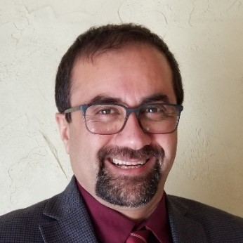
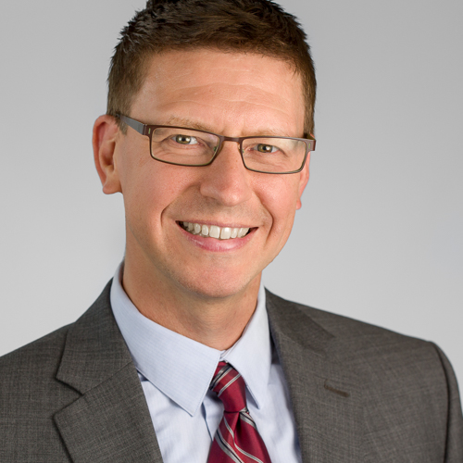
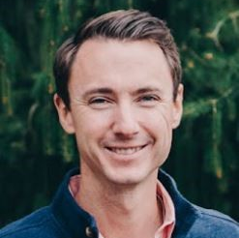
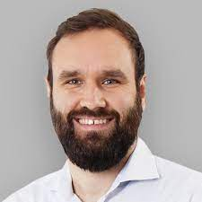
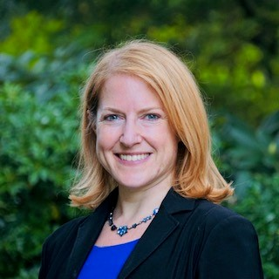
Panel Discussion: Model Credibility Considerations for Different Stages of the Total Product Life Cycle
Tuesday, April 16th
3:15 PM – 4:00 PM
Payman Afshari, PhD DePuy Synthes Senior Principal Engineer
Jeff Bodner Medtronic Distinguished Scientist
Daniel Flo Stryker Manager, Research & Development
Jan Hertwig Simq GmbH CEO
Cassie Scherer, JD Medtronic Senior Director of Digital Health Policy and Regulatory Strategy

Slide 10
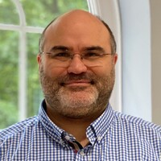
Invited Talk: Digital Evidence for the Digital Era—Opportunities and Challenges for In Silico Methods Across the Lifecycle of Medical Products
Wednesday, April 17th
8:30 AM – 9:15 AM
Professor Alejandro Frangi, PhD, FREng The University of Manchester Bicentennial Turing & RAEng Chair in Computational Medicine, Schools of Engineering and Health Sciences

Slide 11
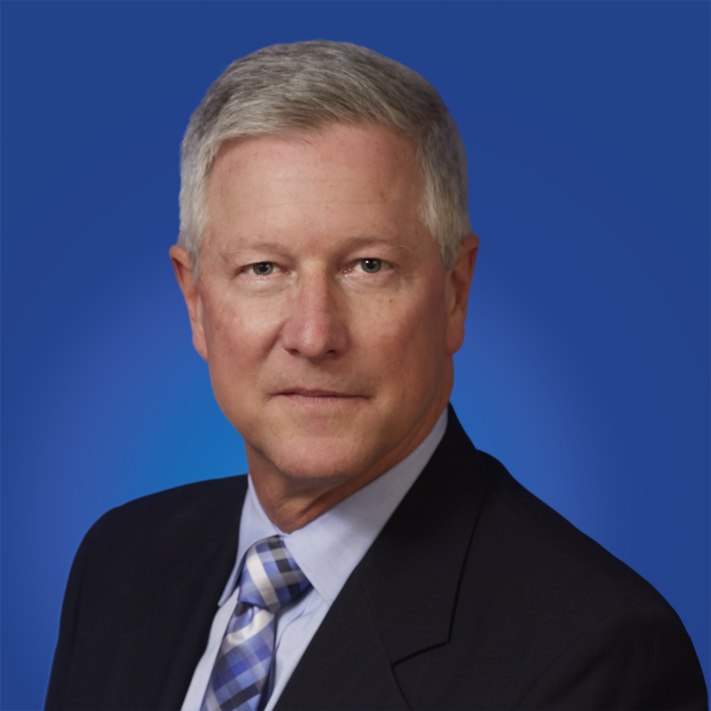
Invited Talk: The National Academies of Sciences, Engineering, and Medicine Report on Foundational Research Gaps and Future Directions for Digital Twins
Wednesday, April 17th
9:15 AM – 10:15 AM
Conrad Grant Chief Engineer The Johns Hopkins University Applied Physics Laboratory

Slide 12
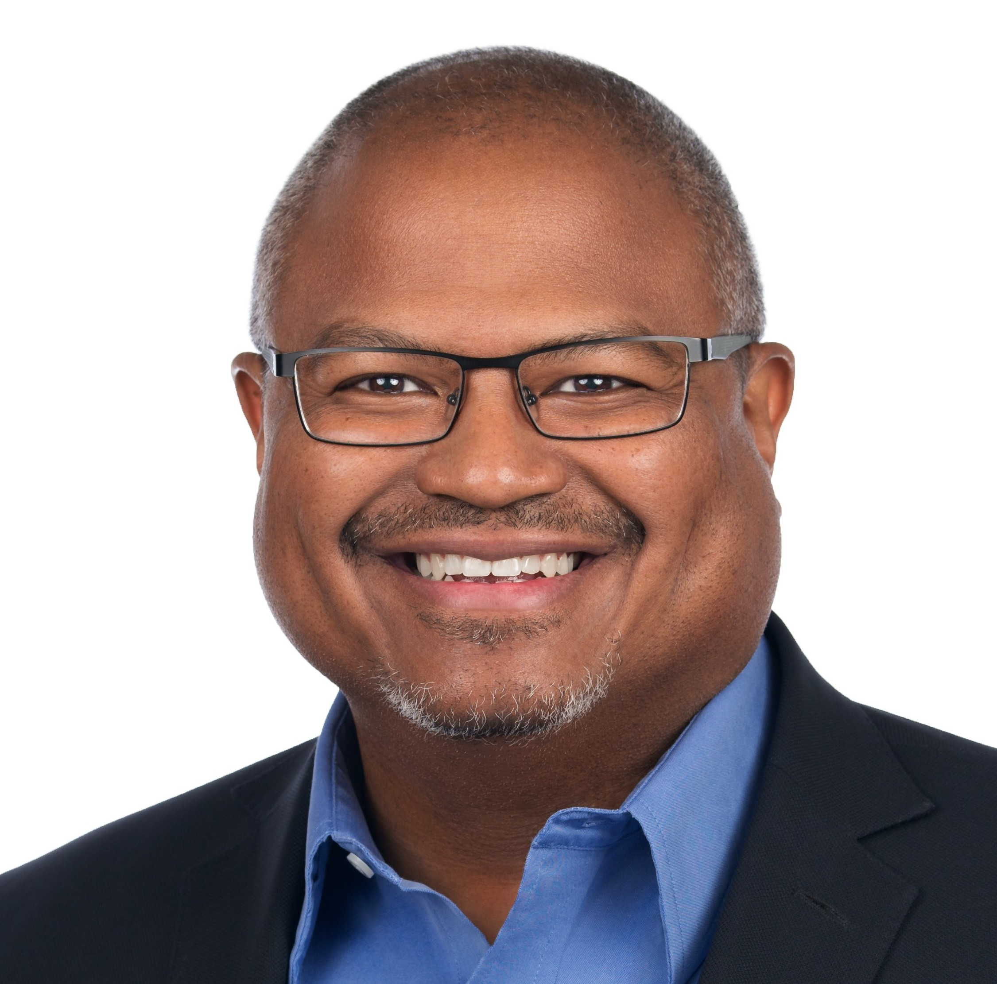
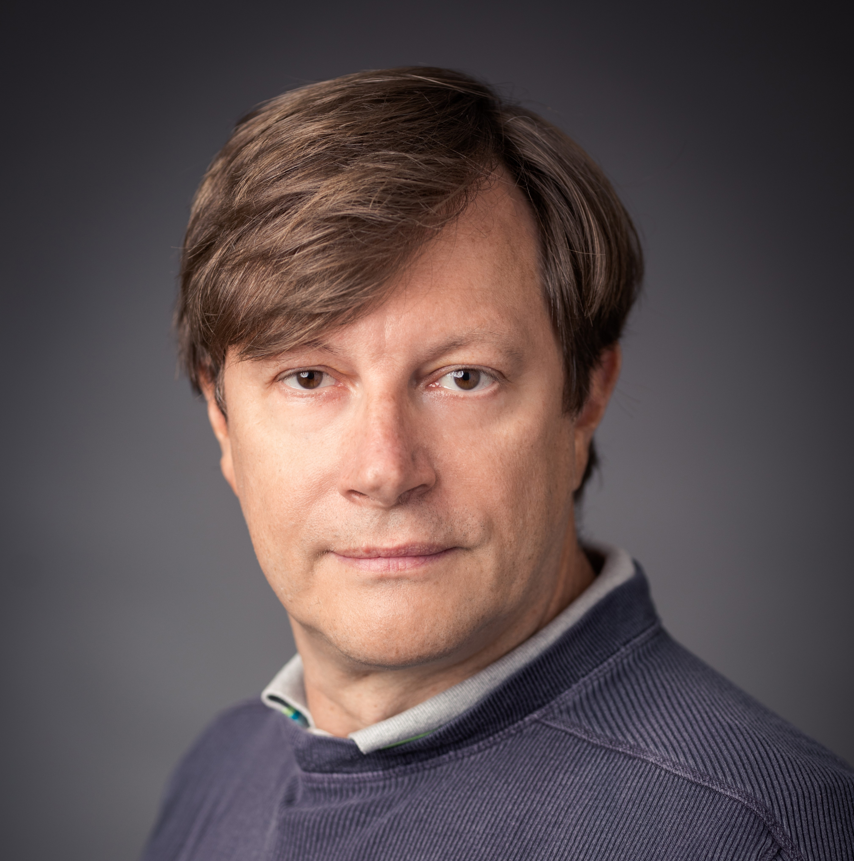
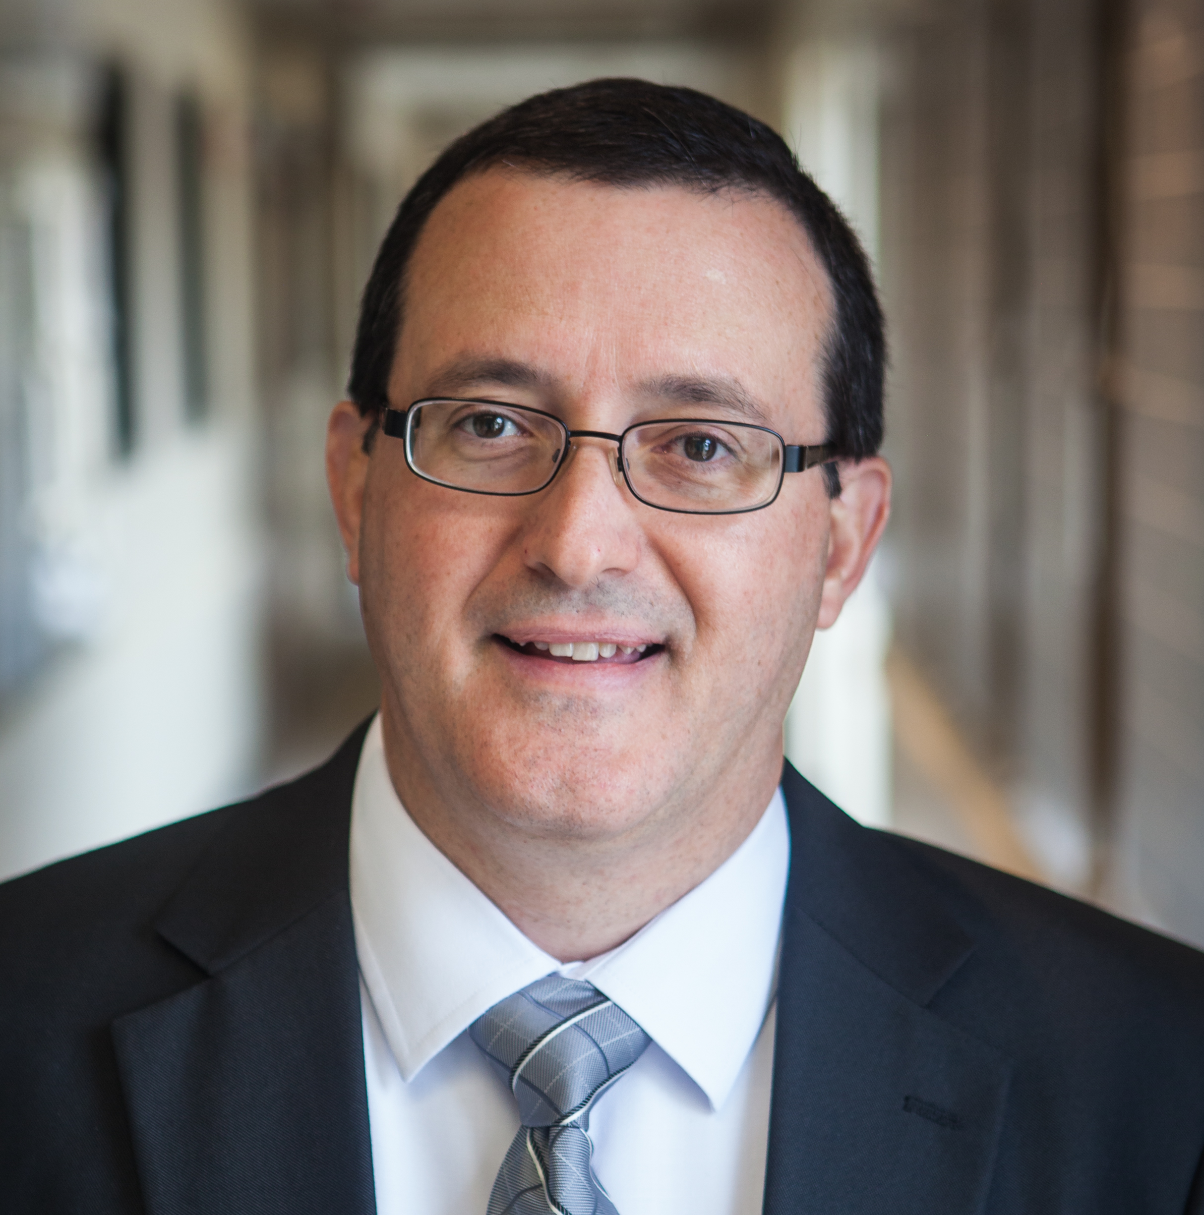
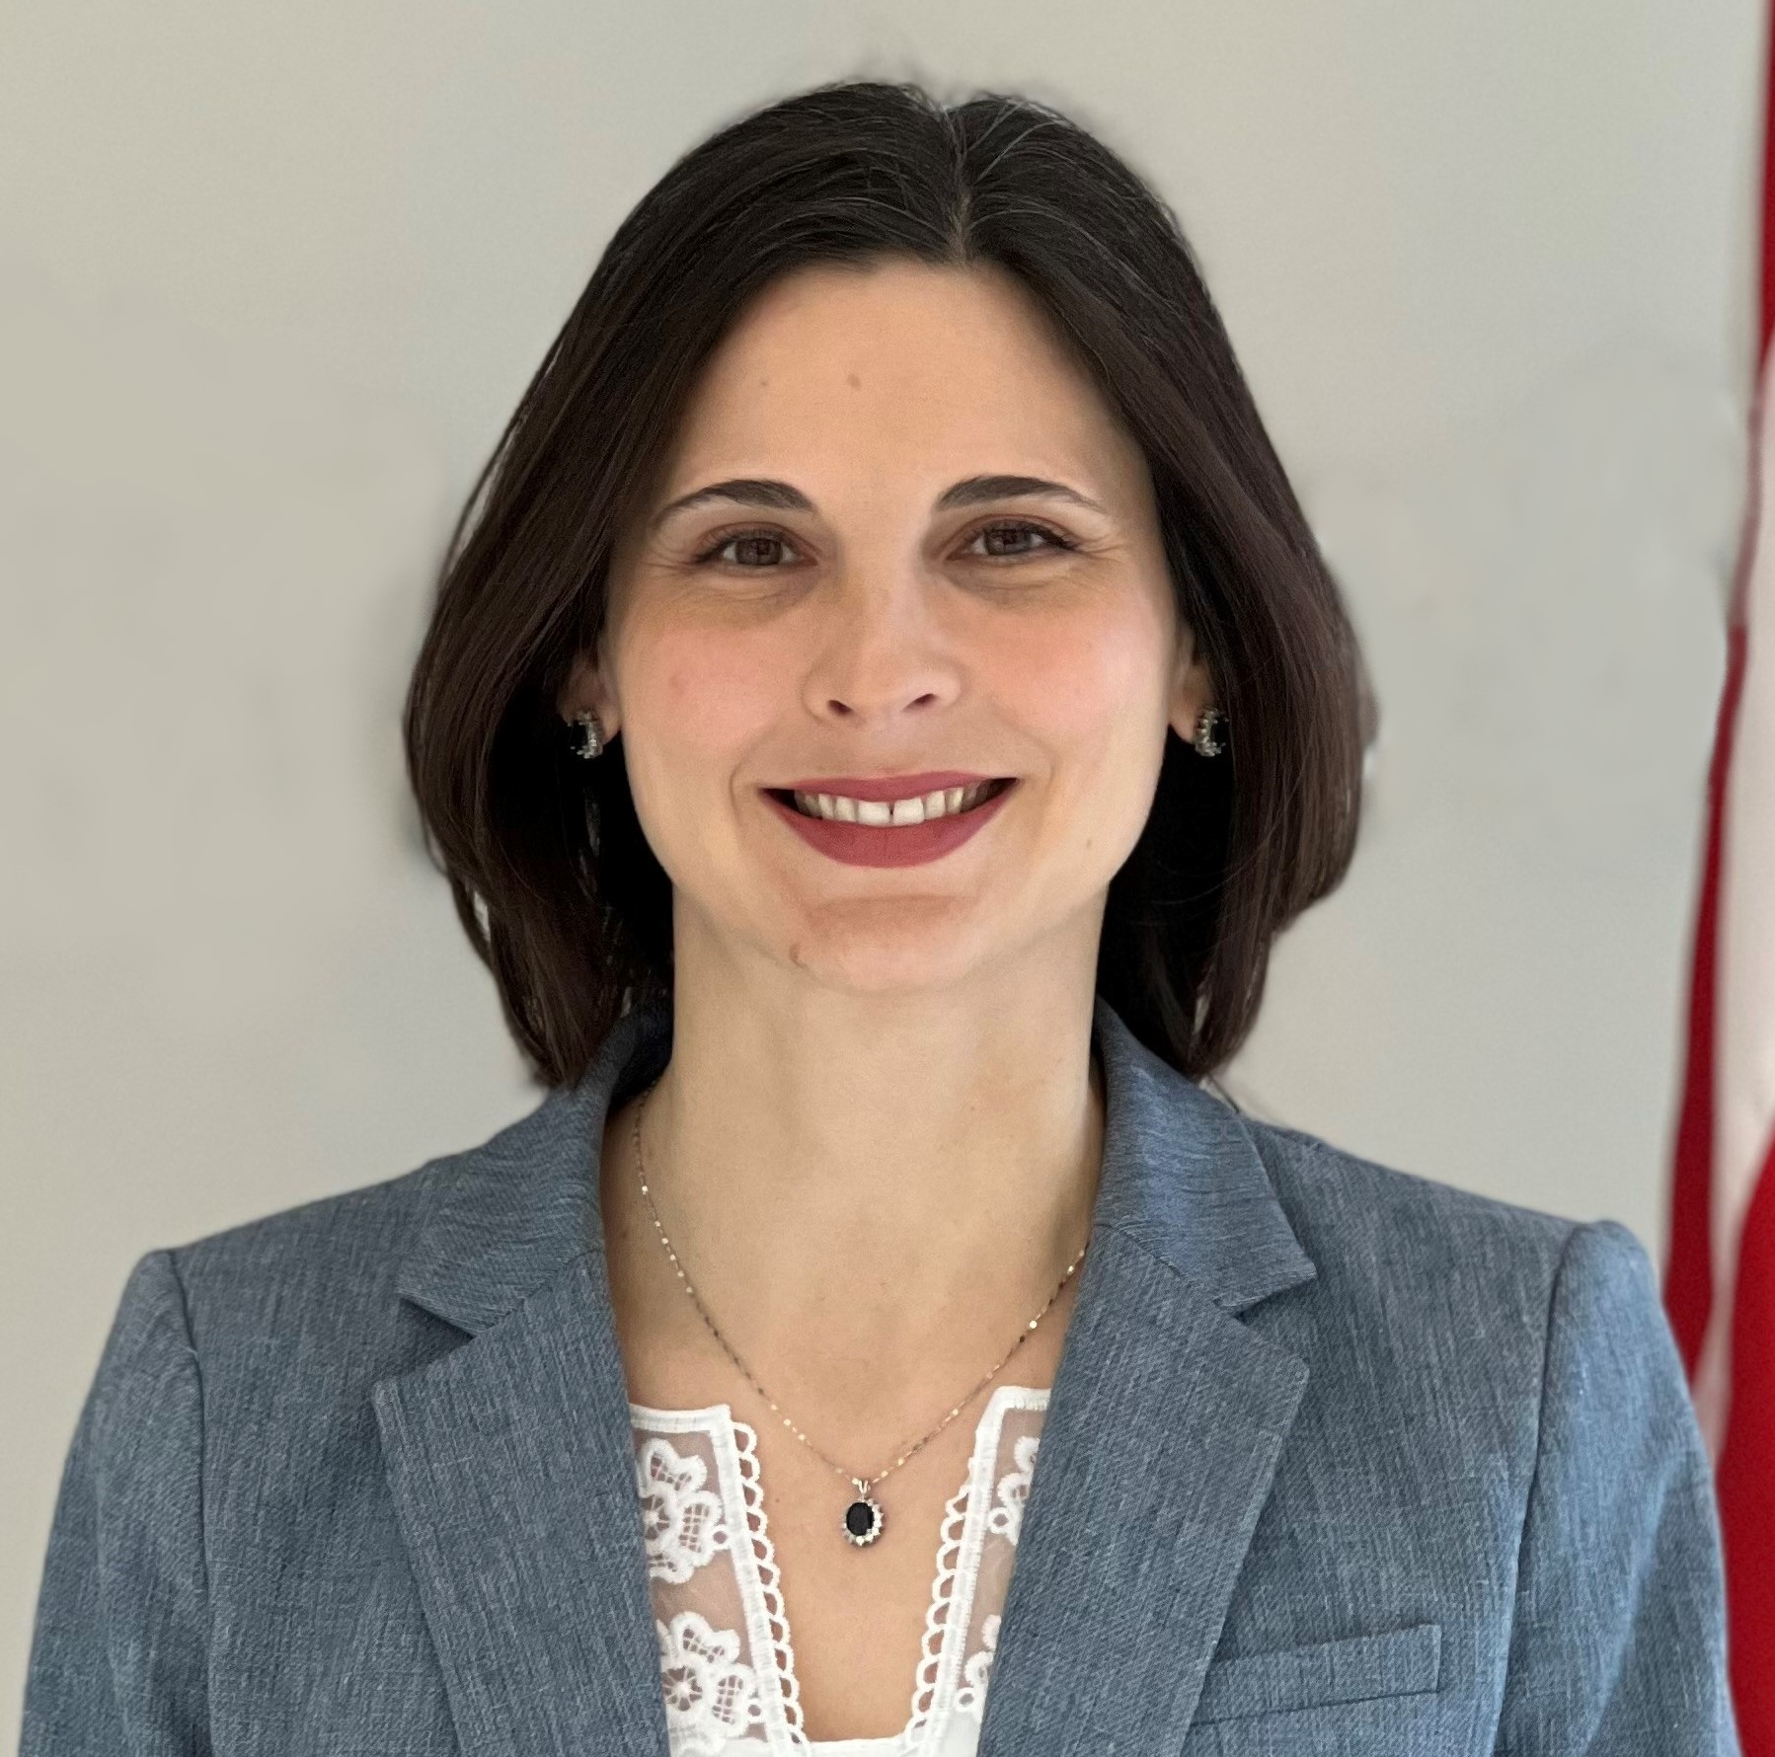
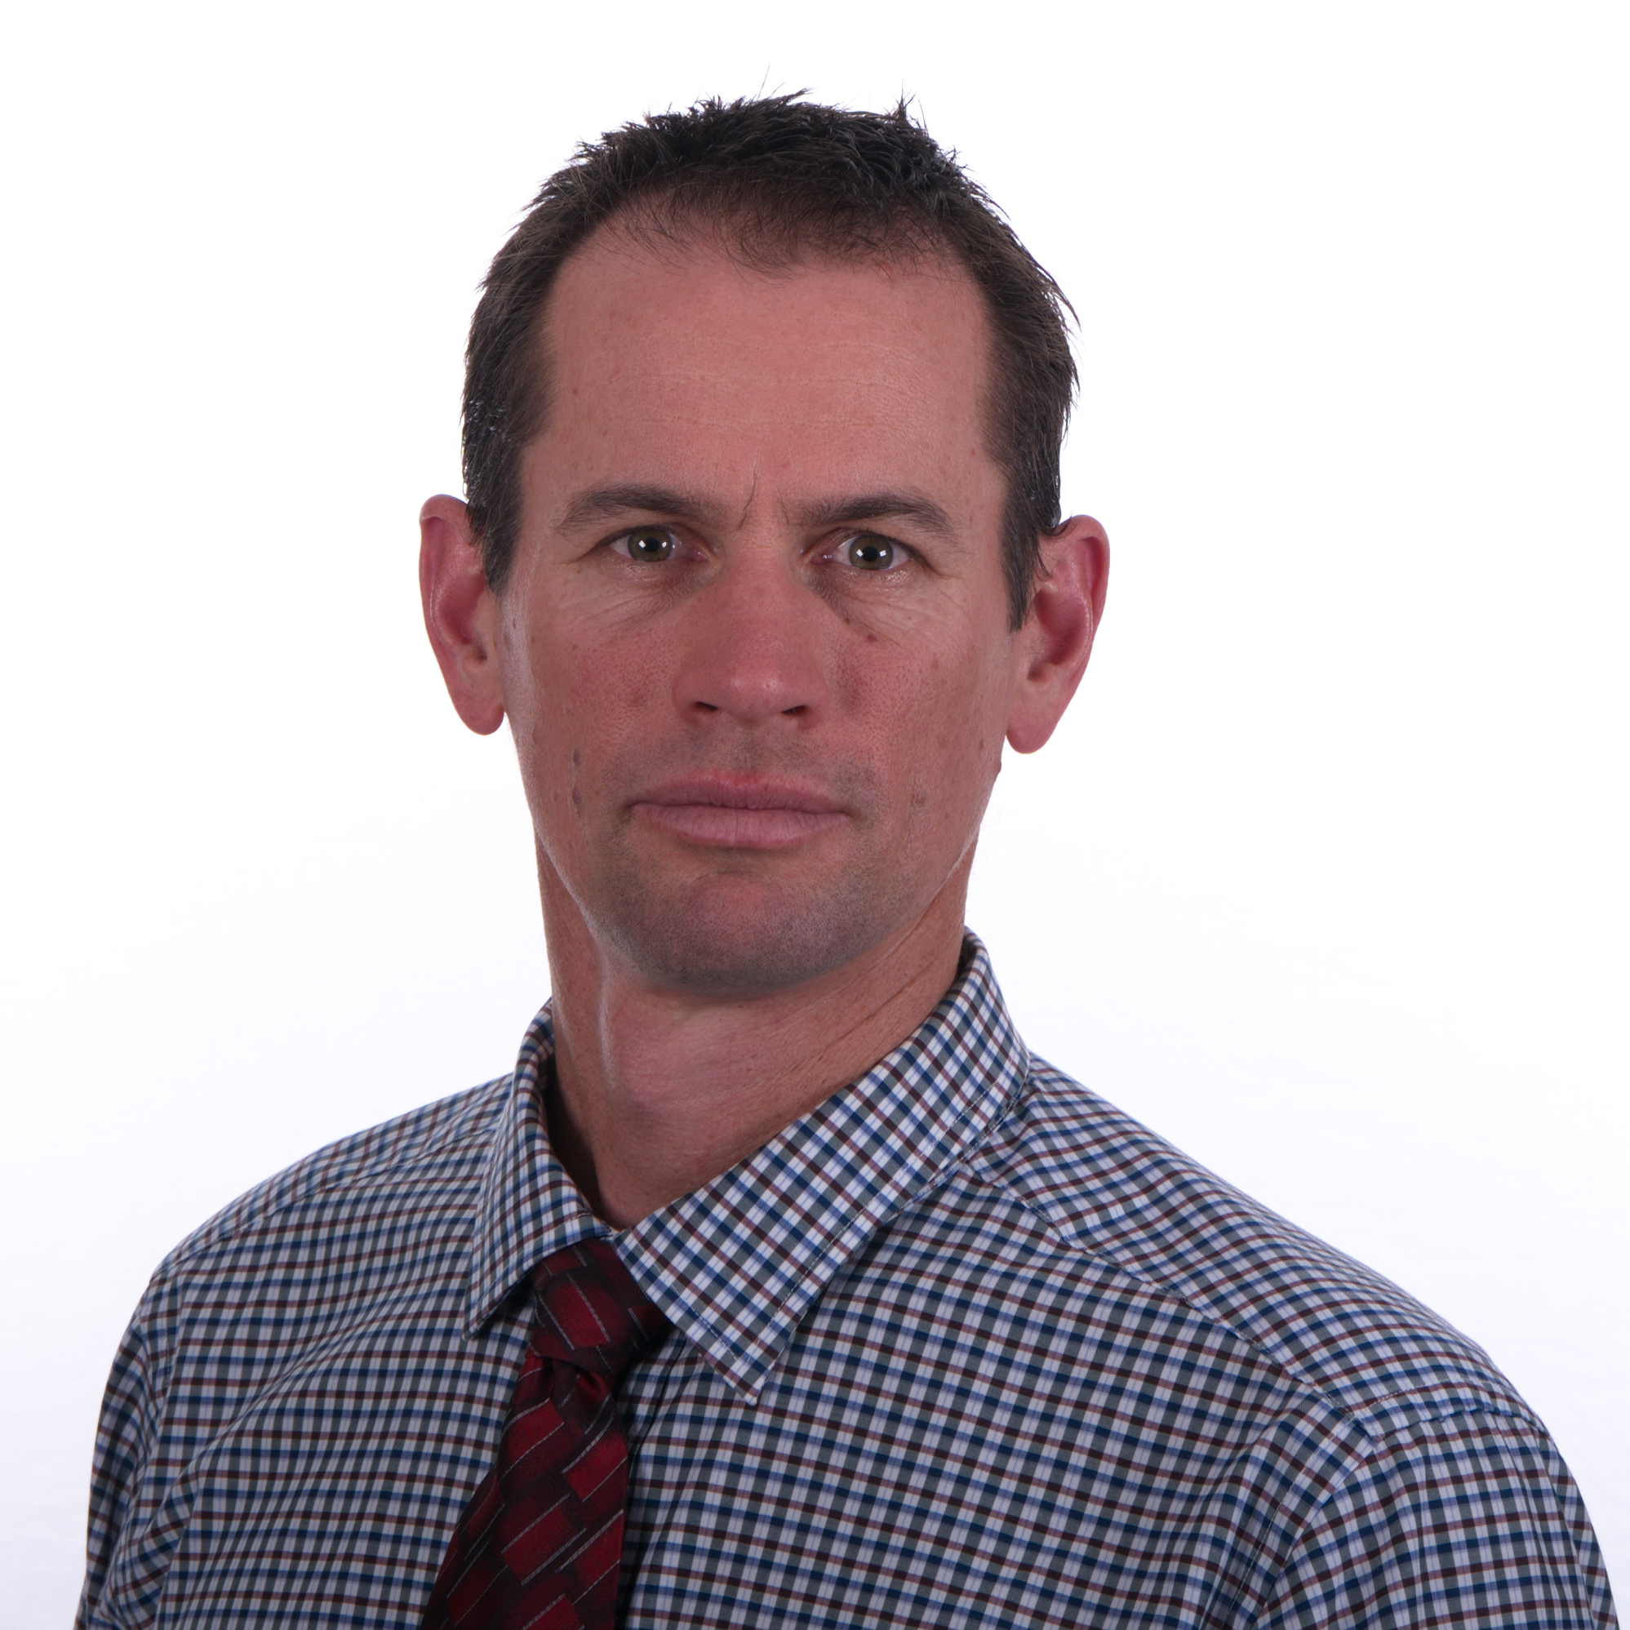
Panel Discussion: Towards Good Simulation Practices
Wednesday, April 17th
10:30 AM – 12:00 PM
Mark Palmer, MD, PhD Ansys Field CTO for Healthcare and Senior Chief Technologist
Luca Emili InSilicoTrials Technologies Founder and CEO
Noel Colon Medtronic Senior Vice President, Research & Development
Tina Morrison, PhD FDA Director, Office of Regulatory Science and Innovation, Office of the Chief Scientist
Ashley Peterson, PhD FDA Vice President, Applied Science

Slide 13
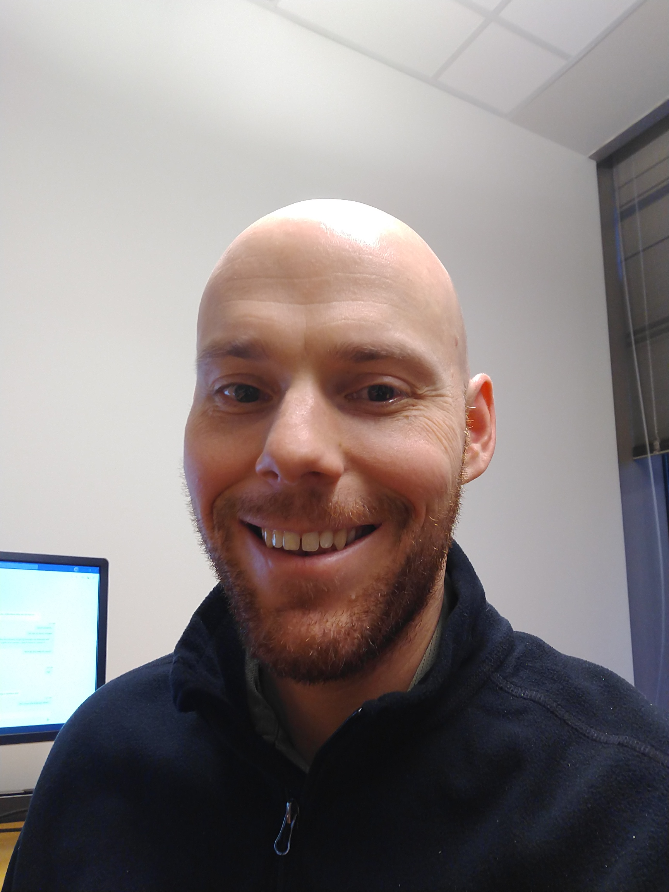
Invited Talk: An End-to-End Example of the ASME V&V 40 Standard: Finite Element Analysis Credibility of Pedicle Screw Systems Under Compression-Bending
Wednesday, April 17th
1:00 PM – 1:45 PM
Andrew Baumann, PhD FDA Assistant Director, Division of Applied Mechanics, Office of Science and Engineering Laboratories, CDRH

Slide 14
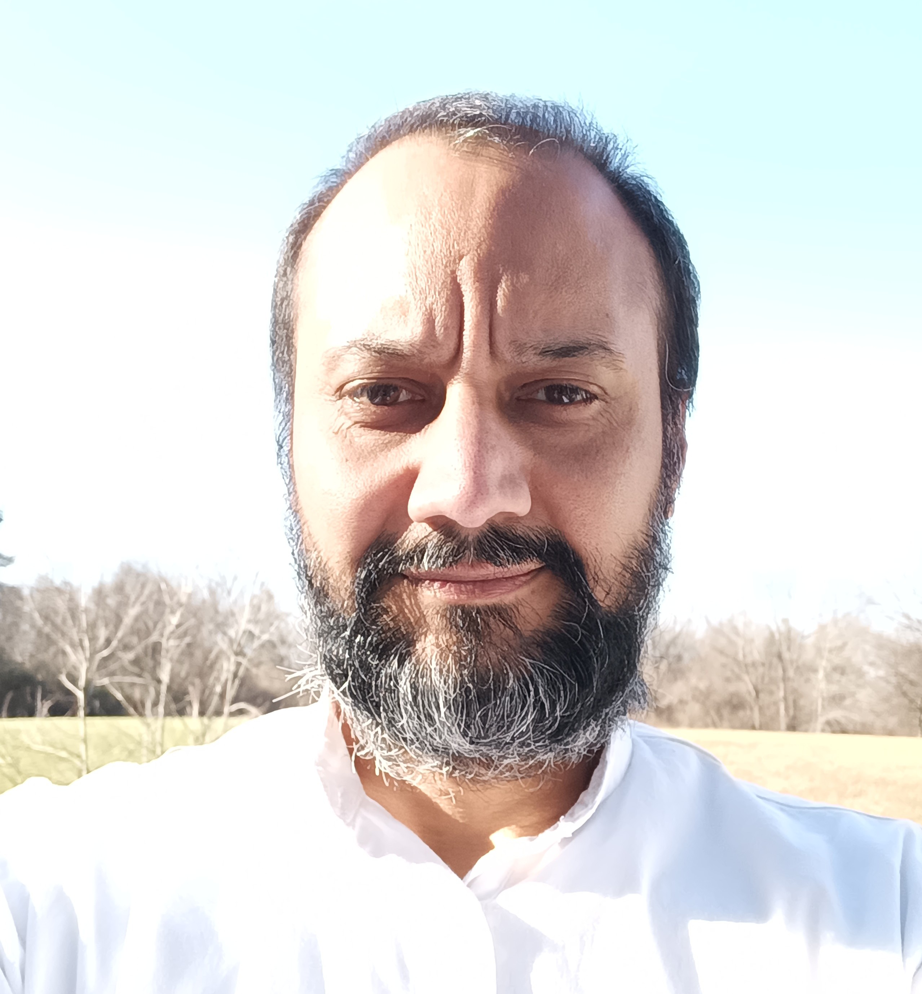
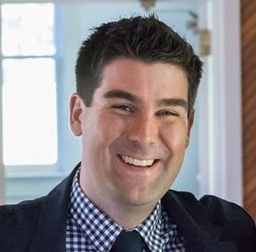
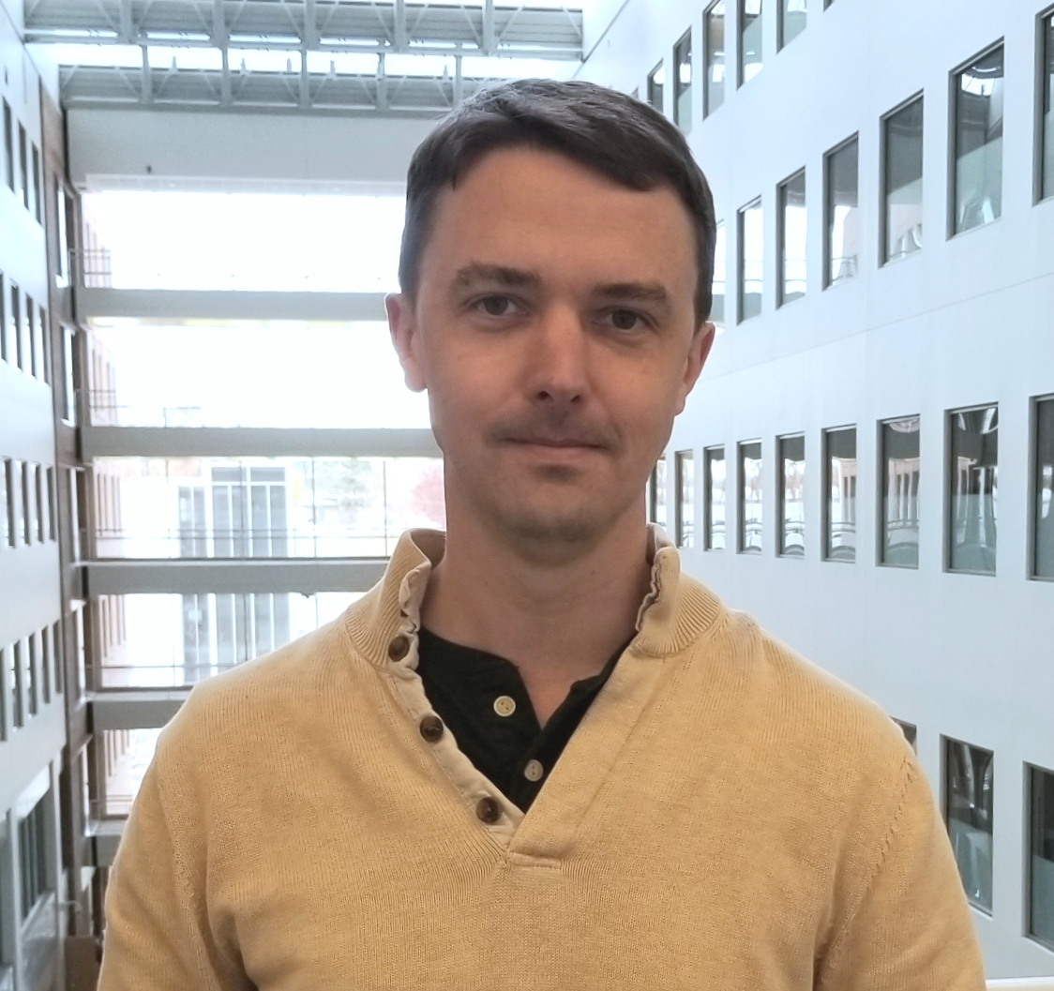
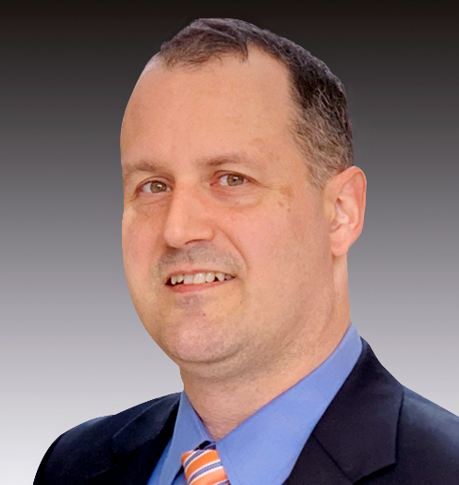
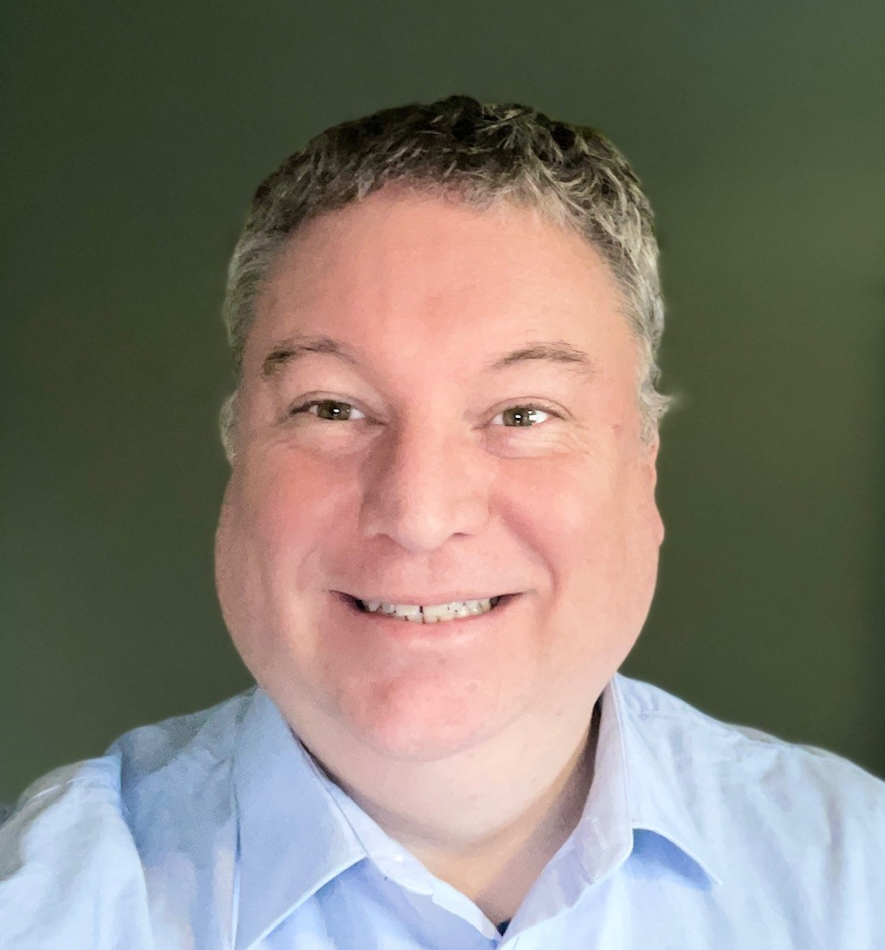
Panel Discussion: International Regulatory Perspective on CM&S
Wednesday, April 17th
1:45 PM – 3:00 PM
Devashish Shrivastava, PhD FDA Biomedical Engineer, Cancer Diagnosis and Treatment Devices Team, Office of Surgical and Infection Control Devices, Office of Product Evaluation and Quality, CDRH
Jeff Ballyns, PhD Becton, Dickinson
and Company Director of Regulatory Strategic Planning for Innovation
Joshua Balsam,
PhD FDA Branch Chief, Diabetes Diagnostic Devices Branch, Office of In Vitro Diagnostics, Office of Product Evaluation and Quality, CDRH
René Bombien,
MD, PhD TÜV SÜD Denmark Medical Health Services Cardiac Surgeon and Chief Medical Officer
Alex Cadotte,
PhD MCRA Vice President Digital Health, AI and Radiology
Gavin Quigley, MBChB, FRCS,
MBA British Standards Institution Senior Internal Clinician
Bahram Parvinian, PhD Lighthouse Regulatory Consulting Principal Consultant

