Slide 1



Medical Extended Reality Summit
Advancements in Technology, Applications, and Regulatory Science
April 16-17, 2024
Hyattsville, MD
College Park Marriott Hotel & Conference Center
REGISTER NOW
#MXR2024

Slide 2
Experience the Future of Medical Extended Reality at #MXR2024
Join a dynamic community of industry leaders, regulatory experts, and technology innovators as we collectively develop a strategic roadmap to drive MXR innovation and foster a collaborative ecosystem.
This exciting two-day regulatory science conference will bring together leaders in Augmented/Virtual/Mixed reality (AR/VR/MR) who are focusing on healthcare applications. Learn about technological advances, current medical applications, drivers of innovation and adoption, and recent regulatory advances in the field of medical extended reality (MXR).

Slide 3
Why attend?
At #MXR2024, we're set to address some of the most pressing questions in the field, such as:
What developments have transpired since the FDA 2020 Workshop on MXR?
How can we effectively navigate the obstacles hindering the seamless transition of innovative MXR devices into widespread clinical use?
What collaborative strategies can we implement to accelerate MXR innovation and adoption?

Slide 4
What are the Goals at #MXR2024?
What’s New in MXR
An update to FDA 2020 Workshop on MXR: What has changed? Where are we? Progress? What are the big challenges that we face today? How to address the challenges?
Discuss Implementation Challenges
Discuss challenges to implementation: Innovative MXR devices are not transitioning effectively from the development stage to clinical use and widespread adoption.
Provide a Neutral Space
Provide a neutral space for stakeholder representatives from industry and regulators in AR/VR/MR.

Slide 5
What are the Goals at #MXR2024?
Develop a Collaborative Ecosystem
Develop an ecosystem to bring disparate components together, facilitate synergies between stakeholders across the total product lifecycle.
Identify an Acceleration Roadmap
Identify a roadmap to accelerate MXR innovation and adoption by clarifying evaluation challenges and solutions.

Slide 6
Who Should Attend #MXR2024?
Medical Device Industry Professionals
Quality & Regulatory (QA/RA) professionals, including those who are responsible for regulatory and economic strategy or implementation of AR/VR/MR
Technology experts that are making advances in the MXR space through new technology or use
Platform Developers
Patients and Patient Advocates
Healthcare Professionals
Early adopters of AR/VR/MR technology in their practice
Those who have used AR/VR/MR but want to learn more
Regulatory Affairs and Policy Professionals

Slide 7
Don’t Miss These Opportunities
Get a Booth!
Engage the MXR Industry
Make an impression on attendees! From exhibiting your latest solution or technology directly to attendees to sponsorship opportunities designed to make a big splash at every budget point, your company doesn't want to miss the chance to be engaged in this first-of-its-kind event! Click to learn more.
Share Your Expertise with a Poster Session
MDIC is pleased to provide an opportunity for various stakeholders in the medical extended reality MXR ecosystem to showcase their work in this field through our POSTER sessions and engage with the conference attendees. Click to learn more.

Slide 8
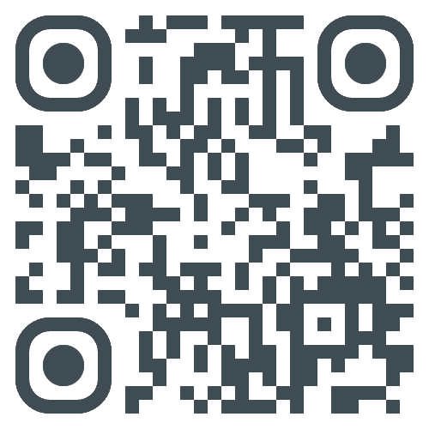
Overview
Agenda
Submit a Poster Abstract
Exhibit and Sponsor
Hotel Reservations
Discover more at
MDIC.org
Additional Inquiries?
Please contact MDIC staff at MXR@mdic.org
REGISTER NOW

Slide 9


Thanks!
Any questions?
CONTACT
Matthew Victoria
Senior Manager, Marketing & Communications
mvictoria@mdic.org

