Slide 1
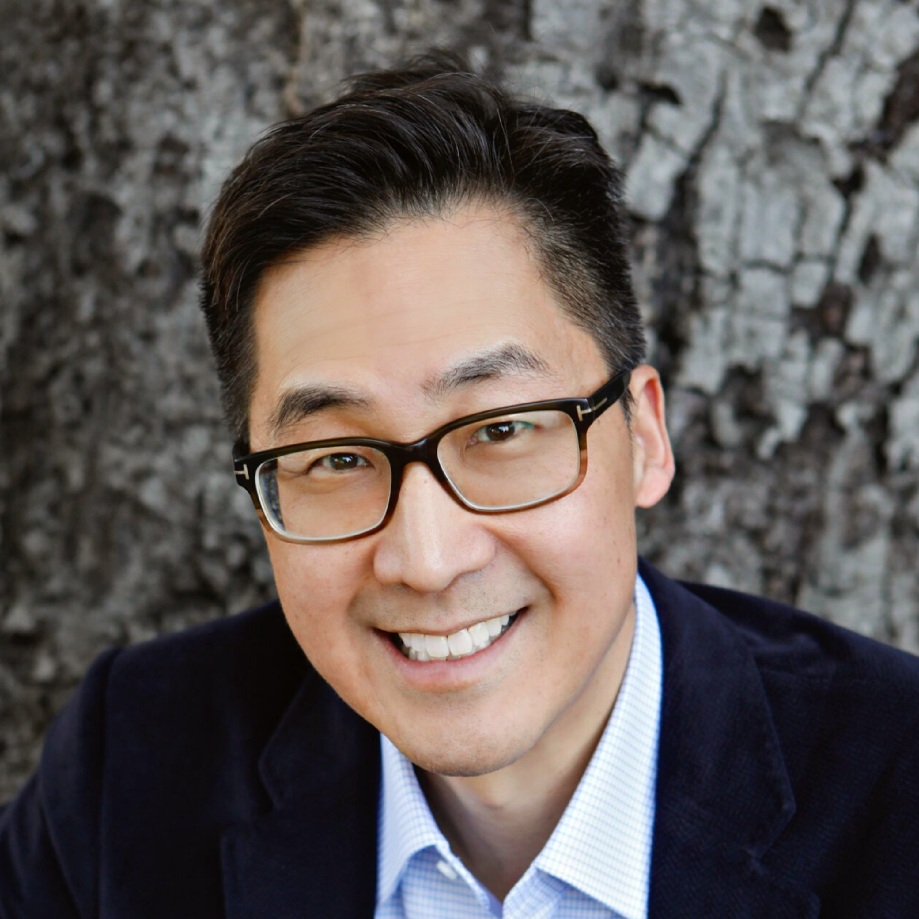
Medical XR Clinician Perspective on Clinical Innovation
Tuesday, April 16th
1:30 PM – 2:30 PM
Laurence Coyne FDA Division Director, OHT6: Office of Orthopedic Devices, OPEQ, CDRH
Laurence Coyne FDA Division Director, OHT6: Office of Orthopedic Devices, OPEQ, CDRH
Laurence Coyne FDA Division Director, OHT6: Office of Orthopedic Devices, OPEQ, CDRH
Laurence Coyne FDA Division Director, OHT6: Office of Orthopedic Devices, OPEQ, CDRH
Christopher Harner FDA Division Director, OHT6: Office of Orthopedic Devices, OPEQ, CDRH
Laurence Coyne FDA Division Director, OHT6: Office of Orthopedic Devices, OPEQ, CDRH
Laurence Coyne FDA Division Director, OHT6: Office of Orthopedic Devices, OPEQ, CDRH

Slide 2
Medical XR Clinician Perspective on Clinical Innovation
Tuesday, April 16th
1:30 PM – 2:30 PM
Laurence Coyne FDA Division Director, OHT6: Office of Orthopedic Devices, OPEQ, CDRH
Laurence Coyne FDA Division Director, OHT6: Office of Orthopedic Devices, OPEQ, CDRH
Laurence Coyne FDA Division Director, OHT6: Office of Orthopedic Devices, OPEQ, CDRH
Laurence Coyne FDA Division Director, OHT6: Office of Orthopedic Devices, OPEQ, CDRH
Christopher Harner FDA Division Director, OHT6: Office of Orthopedic Devices, OPEQ, CDRH
Laurence Coyne FDA Division Director, OHT6: Office of Orthopedic Devices, OPEQ, CDRH

Slide 3
Medical XR Clinician Perspective on Clinical Innovation
Tuesday, April 16th
1:30 PM – 2:30 PM
Laurence Coyne FDA Division Director, OHT6: Office of Orthopedic Devices, OPEQ, CDRH
Laurence Coyne FDA Division Director, OHT6: Office of Orthopedic Devices, OPEQ, CDRH
Laurence Coyne FDA Division Director, OHT6: Office of Orthopedic Devices, OPEQ, CDRH
Laurence Coyne FDA Division Director, OHT6: Office of Orthopedic Devices, OPEQ, CDRH
Christopher Harner FDA Division Director, OHT6: Office of Orthopedic Devices, OPEQ, CDRH

Slide 4
Medical XR Clinician Perspective on Clinical Innovation
Tuesday, April 16th
1:30 PM – 2:30 PM
Laurence Coyne FDA Division Director, OHT6: Office of Orthopedic Devices, OPEQ, CDRH
Laurence Coyne FDA Division Director, OHT6: Office of Orthopedic Devices, OPEQ, CDRH
Laurence Coyne FDA Division Director, OHT6: Office of Orthopedic Devices, OPEQ, CDRH
Laurence Coyne FDA Division Director, OHT6: Office of Orthopedic Devices, OPEQ, CDRH

Slide 5
Medical XR Clinician Perspective on Clinical Innovation
Tuesday, April 16th
1:30 PM – 2:30 PM
Laurence Coyne FDA Division Director, OHT6: Office of Orthopedic Devices, OPEQ, CDRH
Laurence Coyne FDA Division Director, OHT6: Office of Orthopedic Devices, OPEQ, CDRH
Laurence Coyne FDA Division Director, OHT6: Office of Orthopedic Devices, OPEQ, CDRH

Slide 6
Medical XR Clinician Perspective on Clinical Innovation
Tuesday, April 16th
1:30 PM – 2:30 PM
Laurence Coyne FDA Division Director, OHT6: Office of Orthopedic Devices, OPEQ, CDRH
Laurence Coyne FDA Division Director, OHT6: Office of Orthopedic Devices, OPEQ, CDRH

Slide 7
Medical XR Clinician Perspective on Clinical Innovation
Tuesday, April 16th
1:30 PM – 2:30 PM
Laurence Coyne FDA Division Director, OHT6: Office of Orthopedic Devices, OPEQ, CDRH

