Slide 1

Attribute Library:
Project Overview
Deck Overview:
Preference Accessibility Problem
What is the Attribute Library?
Value Proposition
Data, Analysis Collected
Why Build the Attribute Library?
Timeline
Next Steps
Medical Device Innovation Consortium (MDIC)
Center of Evidence and Patient Engagement
Science of Patient Input (SPI)
Project Team: Patient Preference in Device Product Lifecycle (PDL)

Slide 2



Industry first to increase PPI accessibility in US
No Bank of Attributes
Lack of Cross-Comparability
Harder to design Future Studies
When attributes are not comparable. Researchers are not able to fully leverage and utilize past study attributes/results.
When researchers can’t fully leverage past results or attributes, research becomes hard to cross-compare or measure between.
When studies are not as comparable, it leads to future studies becoming more difficult to plan and execute.
Industry FIRST
Project Team: Patient Preferences in Device Product Lifecycle (PDL)

Slide 3

What is the Attribute Library?
AI-enabled publicly accessible database to allow users search, compare and analyze patient preference attributes.
Enables harmonization and accessibility to patient preference research
Project Team: Patient Preferences in Device Product Lifecycle (PDL)
Notes:
MPAE’s definition
Read
But what does that mean in practice
Essentially will allow users to use a centralized platform to search and compare attributes and studies in a systematic and thorough way
This would help standardize preference research and create more efficient and successful future preference studies

Slide 4
Value Proposition
Harmonization:
  Researchers can access and cross-compare past research, streamlining study design and analysis. This harmonization promotes consistency and efficiency in preference research.
Enhanced Patient Involvement:
  Centralizing patient preference data will ensure that patient thoughts, perspectives, and broader inputs are better reflected in the development of all medical technologies.
Device Sector Advancement:
  Bridging the existing gap between the Medical Device field and other more mature preference sectors like the pharmaceutical industry. The Attribute Library will empower researchers to build upon existing research and improve study quality and study volume within under-developed preference areas.
Project Team: Patient Preferences in Device Product Lifecycle (PDL)

Slide 5
Who will use the Attribute Library?
Potential Users:
Patient Preference Researchers
Industry Clinical Trial Developers
Regulators (FDA)
Project Team: Patient Preferences in Device Product Lifecycle (PDL)

Slide 6
Current Data in the Attribute Library
Attribute Library Data Totals:
Studies: 171
Attributes: 1,181
Disease Areas: 4
Disease Area | Number of Studies | Number of Attributes
Cardiology | 46 | 314
Diabetes | 15 | 90
Neurology | 48 | 372
Oncology | 62 | 405
Total | 171 | 1181
Project Team: Patient Preferences in Device Product Lifecycle (PDL)

Slide 7
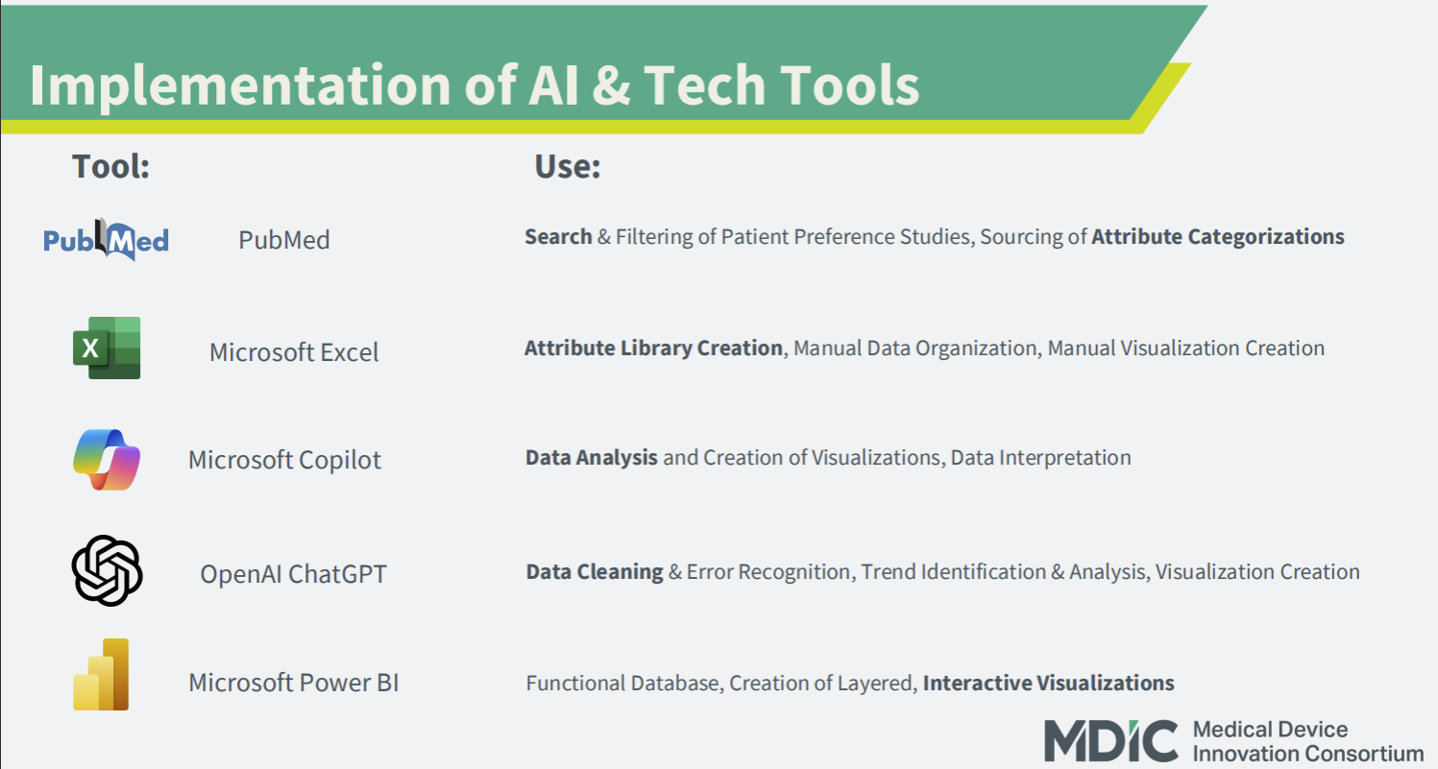
Project Team: Patient Preferences in Device Product Lifecycle (PDL)

Slide 8
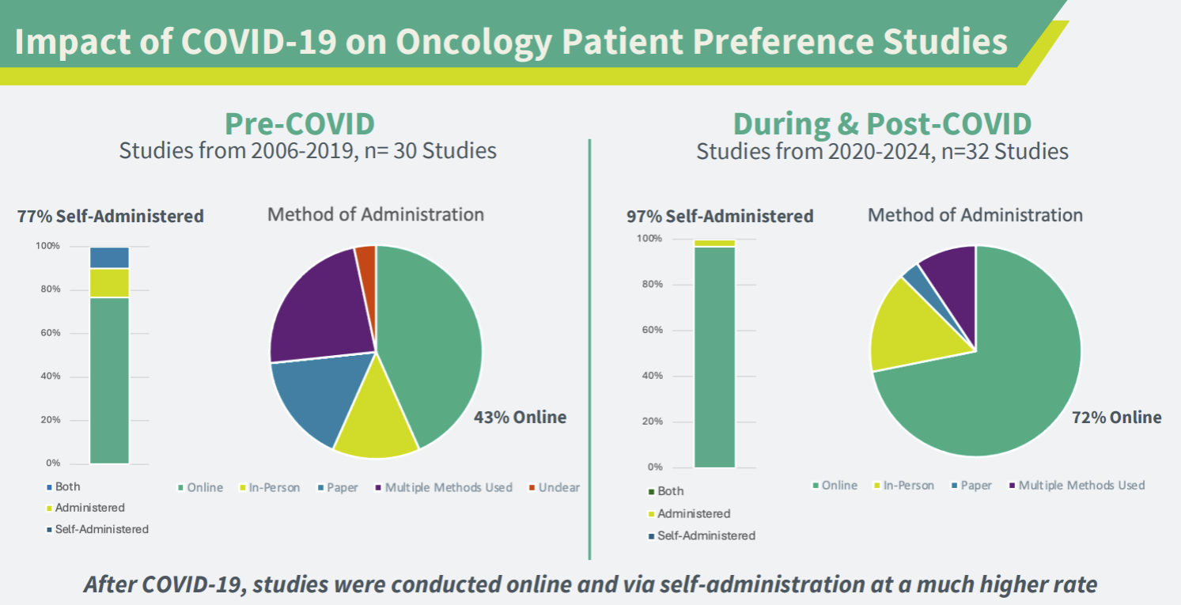
Project Team: Patient Preferences in Device Product Lifecycle (PDL)

Slide 9
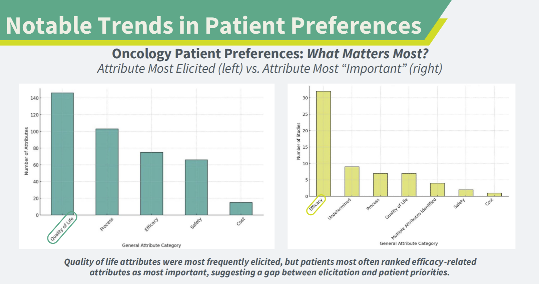
Project Team: Patient Preferences in Device Product Lifecycle (PDL)

Slide 10
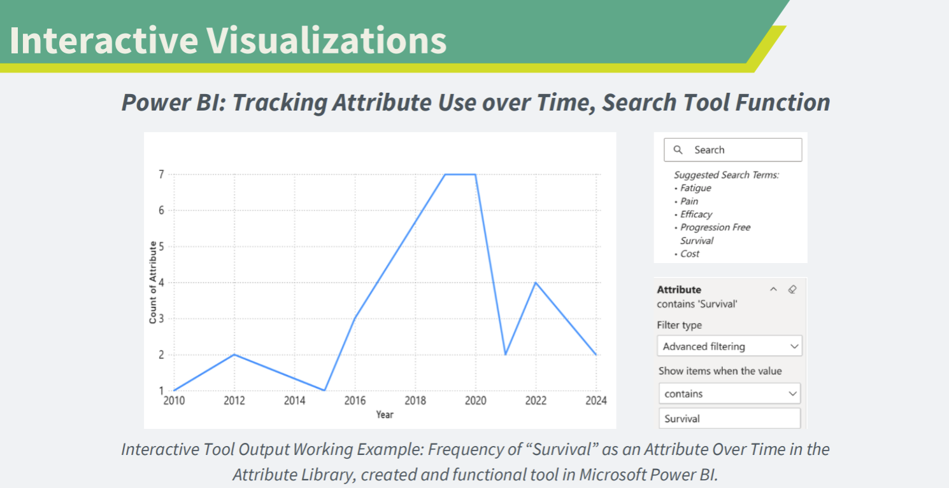
Project Team: Patient Preferences in Device Product Lifecycle (PDL)

Slide 11

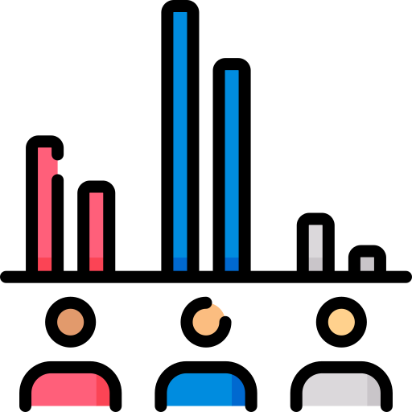

Why Build an Attribute Library?
Boost patient preference and adoption in the medical device field
Enhance patient-centricity within clinical trials and product development
Lead the industry and set a new gold standard for patient preference
Quotes from FDA:
"MDIC has a persistent leadership in PPI” | "MDIC has a powerful voice in that PPI space, the work certainly needs it"
Project Team: Patient Preferences in Device Product Lifecycle (PDL)
Notes:
Attribute Library will lead to increased patient preference usage, and uptake within the medical device field.
Increase patient-centricity within clinical trial design and product development.
We will be at the forefront of an industry. Being able to not only drive the research but define a whole new gold standard for patient preference.

Slide 12













Stakeholders Involved
Industry:
Academia:
Regulators:
Preference Expertise:

Slide 13
Attribute Library Timeline
Public Release
Q4 2025
Q2 2026
Q4 2026
v0: Data Migration
Clean Dataset, Refine
Set up Database Infrastructure
Migrate to Cloud Database
Set up GUI for Pilot
v1: Pilot Limited Release
Create basic version of AL
Forward Pilot to key researchers/groups
v2: Tier 1 (Free) Features
Input Use Cases from Pilot
Release with Manual Data Input Section
v3: Tier 2 ($$$) Premium Features
Advanced Data Analysis, Dashboards
Automated Data Intake Tool
Potential AI Tools
Refined Interface, Basic Data Analysis
Self Funded
Requires Funding

Slide 14
Next Steps
Refine Current Data Set
Design functional visualizations through case applications
Create MVP of Attribute Library for a Developer
Ensure syntax and data integrity is up to standards
1.
Identify, Evaluate other potential AI Tools or Extensions to use
Line up relevant case examples to test out initial functions
2.
Raw Data Set
Dashboard Interactions
Custom Search Function
User Entry of Studies
Determine proper vocabulary, terminology around data (”Raw vs Unique Attributes”)
3.
Notes:
Refine Current Data Set
Ensuring clean dataset from what we have
Design other functional visualization possibilities using current Excel Format
Create MVP of Attribute Library for a Developer (using Excel)
Raw Data Set
Dashboard Interactions
Customizable Search Function
User Entry of Studies

Slide 15
Thank you!
The Attribute Library is not publicly accessible yet.
If you want to see a demo, or learn more on how you can support this: Reach out to Jonah Golder at MDIC (jgolder@mdic.org).
Check out our web page here

Slide 16
Attribute Library Data Collection Summary
These are the list of fields initially collected
Opportunity: Attribute Library can enable users to input their own respective Studies, Attributes
Attribute Data
Attribute | Number of Levels | Description of Each level | Short Description of each Attribute (Label) | Extended Description of each Attribute | How were the attributes filled out? (Online, Phone, paper, in-person, both) | How were the attributes administered? (self-administered, administered, both) | Type of List (Numeric, Ordinal, Nominal) | Were Visual Depiction of Attributes (Pictures/Diagrams) Used? (Y/N) | Categorization of Attribute Content (Deterministic, Probabilistic) | Number of Attributes in Preference Elicitation
Population Information
Categorization of Study Population (Patients, Providers, Caregivers, Public, Other) | Study Sample Size (# of participants, if multiple groups are present- use smallest group)
Paper Information
Any limitations cited by the author (List limitation, or No) | Evidence of its use in Regulatory Submission (FDA, EMA, HTA) (Yes, Unknown) | What type of study? (DCE, BWS case 1, BWS 2/3, Threshold Technique, Standard Gamble, Time Tradeoff, AHP) | Study Title | Author List | Journal | Year | Disease Area | Therapeutic Area | Link to Published Work
Working Group: Patient Preferences in Device Product Lifecycle (PDL)

